Slide 1
The 80’s and end of the cold war
Gag me with a spoon

Slide 2
DÉTENTE
Détente - a relaxation of tension. In this context, it means a warming of relations between the Soviet Union and the United States
describes Soviet-American relations from the late 1960s to 1979.
NUCLEAR PARITY DÉTENTE
Detente occurred because the two superpowers had achieved nuclear parity
ACCOMPLISHMENTS OF DETENTE
a) Nuclear Non-Proliferation
Treaty In 1968, the United States, the Soviet Union, and Great Britain led the world in signing a treaty which would limit the spread of nuclear weapons
b) Strategic Arms Limitations Talks
By 1972, SALT One - Soviet Union and the United States would limit number of certain Inter-Continental Ballistic Missiles (ICBMs).
By 1979 , SALT Two was ready, which was intended to accomplish nuclear parity.
However, the Soviet invasion of Afghanistan = U.S. President Carter delays approval.
Ronald Reagan, replaced Carter in 1980, said would abide by spirit of SALT II, but completely ignored it stepped up the arms race to new levels

Slide 3
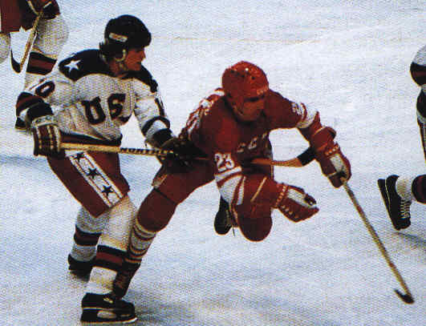
Cold war continues
1979- Invasion of Afghanistan by USSR
1981 – the U.S. government announced a massive increase in defence spending, with most of the money to be spent on modernizing the U.S. nuclear arsenal.
1983 – Soviet jets shot down a Korean passenger jet that had strayed into Soviet air space.
3. A month later, U.S. forces invaded Caribbean nation, Grenada, and took out a pro-Soviet government.
4. The U.S. carried on a covert (secret) war against the left-wing Sandinista regime in Nicaragua.
5. Each superpower accused the other of provoking war, and watched nervously for any sign of attack.
6. Prime Minister Trudeau appealed to the U.S. and the Soviet Union to show more restraint.
7. 1984 – Pierre Trudeau retired from politics.
Miracle on Ice, 1980 Olympic Hockey

Slide 4
THE END OF THE COLD WAR
1. Soviet leader Mikhail Gorbachev realized that the Soviet Union could no longer afford its costly arms race with the United States.
He proposed massive cuts in the arsenal of both superpowers.
He began a series of sweeping economic, social, and political reforms that would help the communist countries run more efficiently and create better conditions for their citizens.
He loosened censorship; allowed greater freedom of speech
These policies, called perestroika (reconstruction) and glasnost (openness), encouraged people of East Germany, Czechoslovakia, Poland, Hungary, and Romania to demand similar reforms in their countries.

Slide 5
2. 1989 – East German border guards, who earlier would have shot anyone crossing the Berlin Wall, watched people from East and West demolish it. Rise of Berlin War, Tear it Down Speech, Fall of Berlin Wall
3. Even the powerful Soviet Union fell apart, as member states became independent countries.
4. Communist China, too, experimented with a kind of perestroika, allowing capitalism to expand in many areas of the economy.
But hopes for political freedom were crushed when red army soldiers
attacked students involved in a democracy movement in Tiananmen
Square in 1989, killing hundreds, maybe thousands.
5. With the dissolution of the Soviet Union in 1991, the great division between East and West – between the communist and non-communist world – was gone.

Slide 6
Life in Canada during 1980’s
Uh, the rise in consumerism and materialism.
And the Me Generation
Check it out

Slide 7
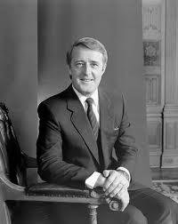
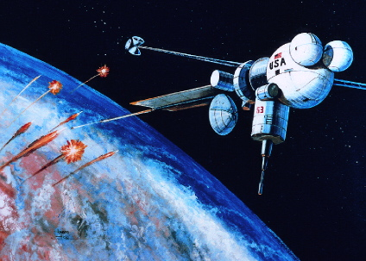
MULRONEY ERA: CLOSER TIES With THE Us
1984 – Conservative leader Brian Mulroney became Canada’s PM. He developed a close personal relationship with U.S. President Ronald Reagan, with whom he shared a similar conservative philosophy.
2. 1985 – the U.S. government announced a plan to create a defence shield, part of which would orbit the Earth – Strategic Defence Initiative (SDI), nicknamed “Star Wars.”
3. Canada belonged to the North American Aerospace Defence Command (formerly NORAD).
4. Across Canada, anti-nuclear groups protested Canada’s possible involvement.
5. Prime Minister Mulroney said no to Canada’s official participation, but private Canadian companies could bid on Star Wars contacts if they wished.

Slide 8
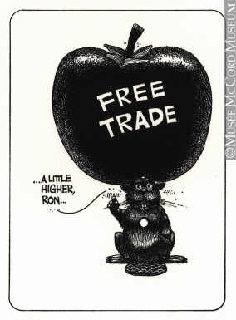
6. In 1973, the Trudeau government had formed the Foreign Investment Review Agency (FIRA) to block any foreign investment that seemed not to be in Canada’s interest.
7. Mulroney dismantled FIRA and replaced it with Investment Canada, a body that would encourage suitable foreign investment.
8. 1987 – Mulroney started negotiations that led Canada into the Free Trade Agreement (FTA) with the United States. It removed tariffs on goods crossing the border, and opened Canada to U.S. investment as well as opening the United States to Canadian investment.

Slide 9
9. Free trade agreement - controversial
Arguments for:
1. By eliminating tariffs, Canada would attract more U.S. investment, which would help Canadian industry grow and benefit the whole economy.
2. It would also provide access to the larger U.S. market, which would increase Canada’s productivity and growth.
3. Canadian products could be sold at lower prices to compete effectively with imports.
4. would also attract U.S. firms to Canada to take advantage of our natural resources, skilled workers, and well-planned transportation system.
Arguments against:
1. Once protective tariffs were removed, those U.S. branch plants operating in Canada to avoid paying tariffs would simply return to the United States, eliminating hundreds of thousands of jobs in Canada.
2. Canadian businesses would be unable to compete against giant U.S. companies, which were able to flood the Canadian market with cheap goods and services.
3. Free trade threatened Canada’s independence, economic union would lead to pressure for political union as well.

Slide 10
The Conservative government was defeated in 1993
The Liberal government under Jean Chretien did not undo the North American Free Trade Agreement, which came into effect in 1994

Slide 11
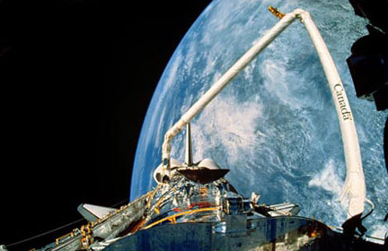
And remember…CANADARM
a) Contract with NASA In 1974, NASA awarded Canada the opportunity to design, develop and build the Shuttle Remote Manipulator System (SRMS). The result was the Canadarm, a IS-metre long robotic arm for which Canada invested $100 million.
b) Canadarm made its debut in November 1981, and has yet to malfunction during more than 50 missions since.
c) Through the development of the Canadarm for NASA, Canadians gained worldwide recognition for their expertise in robotics.

Slide 12
HEALTH CARE IN CANADA
Essentially, we pay for our health care through taxes.
THE CANADA HEALTH ACT (CHA) 1984 - all Canadian citizens have equal access to medically necessary services such as hospital visits, surgeries, and family doctor visits regardless of their ability to pay
The benefit of this system is that whether you are homeless or a millionaire, you can go to visit a doctor or a hospital and get the same level of care without paying anything out-of-pocket.
problem with this system is that it has become very expensive
Also, because there are no user-fees, some people go to the hospital or doctor's office very frequently, sometimes unnecessarily.
because there is not enough money to pay for everything, waiting lists develop

Slide 13
THE FUTURE OF HEALTH CARE IN CANADA
Concern that if the system continues to be run in its current manner it will go bankrupt
-There are many differing opinions on what should be done:
1. Many believe that we should turn to a more "American-style of healthcare," with private doctor's offices and hospitals, as well as public ones. This is called a two-tier system. At private clinics, those who could afford to pay, or had insurance (for which they would pay themselves) would receive their healthcare faster by paying for it. WHAT’S THE ISSUE WITH THIS?
2. Privatization – govt allowing private companies provide some services cleaning staff and food services. WHAT’S THE ISSUE WITH THIS?
At present, the healthcare system in Canada is in a state of flux. While most people agree that it cannot continue on its current path towards bankruptcy - no consensus on how to fix it
Opponents argue that if this occurs, there is the potential for govt to reduce level of services at public doctor's offices and hospitals causing the "poor" to receive lower quality care
Opponents argue that many jobs will be lost and the quality of services will be severely compromised.

