Slide 1
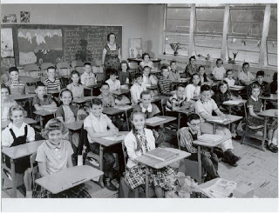
Life in Canada 1950s and 1960’s

Slide 2
Canada after WWII
Returning veterans provided counseling and financial aid to help adjust
1948, Canada gave $2 billion to Western Euro through Marshall Plan
devised by US to send food, equipment, materials to Euro to help rebuild and avoid communist takeover.
Growth in mining and oil – 1947 oil in Alberta
needed to be moved to Eastern Canada
trans-Canada pipeline built after much debate in HofC
many angry over pipeline mis-managed pipeline debate-Liberals lost election 1957
Urbanization (moving to cities)
Suburbs-housing developments on outskirts of cities
Community by car (getting bigger/faster) from “burbs” to work in cities
Car market exploded (boosted petroleum industry)
New technologies
CANDU nuclear reactor (1952)-safe, efficient production of electricity
Alouette I – Can. 1st satellite launched by NASA 1962

Slide 3
Social Changes
Baby Boomers Returning soldiers reunite, financially stable – good time to start family
Immigration Policy
Displaced Persons (forced from homeland due to war)arrived in Canada
Immigration Act of 1952 – would continue practice of barring immigrants from Can. based on ethnic origin would continue
Demand for Immigrants – by 1950’s doors open with demand for immigrant labour
Social Welfare
Social Security – Unemployment Insurance Act – 1940 (bioweekly payment to those who lost job
Family allowances (baby bonus) 1945
1966, Pearson’s govt began Canada Pension Plan
Also introduced Canada’s universal health care, Medical Care Act
Govt accept social security as responsibility (result of Great Dep.)

Slide 4
Social Change (cont)
Entertainment
By 1960’s watching TV favourite family passtime
CBC showed pop. Amer. Shows like “Ed Sullivan Show” (teens influenced w/ rock ‘n’ roll in their living rooms)
Hockey Night in Canada
Paul Henderson scored winning goal for Team Canada in best of 8 Summit Series against Soviets) – Cdn hockey supremacy was reaffirmed, Cdn pride and nationalism

Slide 5
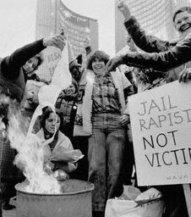
Era of Protest
Teen culture
(don’t trust anyone over 30) – change outdated traditions
Counterculture
challenge authority – Establishment (people who controlled govt, business)
Protest over rights for aboriginals & black North Americans
Against Nukes, Amer interference in Can. & Vietnam
Civil rights movement in US led by MLK and Malcolm X led to improved civil rights for Blacks in US (African-Cdn also lobby for rights)
Women’s Liberation Movement
sought changes in employment
practices, life choices, & politics
After WWII, many women laid off, but some wanted
to have career & family (part of workforce
1921- 18% 1971 39%)
Still faced discrimination and paid less for same work
Few women in politics

Slide 6
Changing Values
Diefenbaker and Cdn Bill of Rights 1960
Protect fundamental human rights
Life, liberty, security of the person & enjoyment of property
Freedom: speech, religion, assembly
More liberal lifestyles by 1960’s
Parliament passed more liberal laws: abortion, homosexuality & divorce (Omnibus Bill Bill C-150)
“There’s no place for the state in the bedrooms of the nation.” PM Trudeau
Birth control bill gives women control over life choices
People question old ideas
Future of Canada
Relationship w/ US
Environment

Slide 7
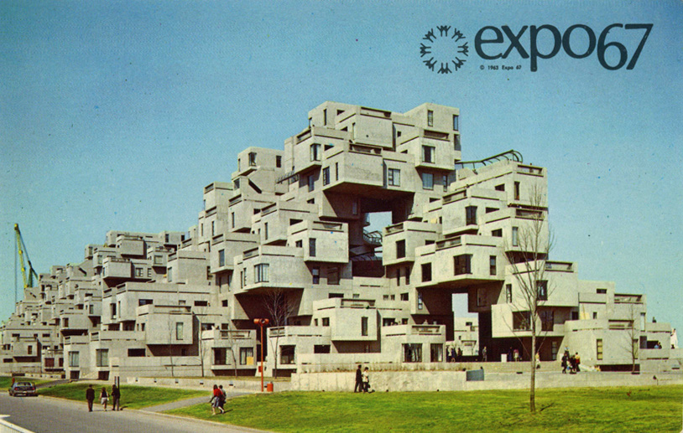
Social Values (cont)
EXPO ‘67 – world fair in Montreal
Cdn show off and celebrate 100 years of accomplishments
Leaders from around world came
French pres General de Gaulle, shouted to crowd at end of his speech infamous phrase and further ignited Fr/Eng Cdn tensions: “Vive le Quebec! Vive le Quebec libre!”
Trudeaumania
Desire for political change too
1968, Pierre Trudeau (Liberal) elected PM
Crowds loved him, esp. the ladies
Charismatic, stylish, youthful, casual
Multiculturalism intro 1971 by Trudeau
-encouraged ethnic groups to express their cultures
-make residents feel at home in Canada
-prevent racism by promoting respect of all cultures

Slide 8
The Other Canada
Aboriginal Nations faired poorly economically during WWII; suffered environmental damage by resource industries
Aboriginals on reserves won right to vote 1960
Still suffered poverty, poor health, housing and education
Those that left reserved, discriminated against
By late 1960’s organize to pressure Ottawa
White Paper 1969
would end special status for Aboriginal people
encourage to leave reserves and become part of mainstream Cdn society
Assimilation was to end their problems
Aboriginals furious
demanded self-government not assimilation
White Paper abandoned
Educational reform – residental school system winds down in ‘70s for band schools.

