Slide 1
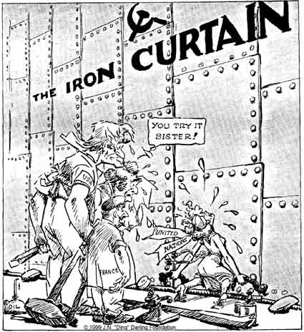
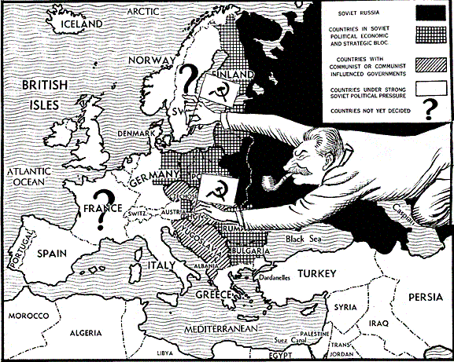
Canada and in a Cold War World

Slide 2
The Ideological Struggle
Soviet & Eastern Bloc Nations [“Iron Curtain”]
US & the Western Democracies
GOAL → spread world-wide Communism
GOAL → “Containment” of Communism & the eventual collapse of the Communist world. [George Kennan]
METHODOLOGIES:
Espionage [KGB vs. CIA]
Arms Race [nuclear escalation]
Ideological Competition for the minds and hearts of Third World peoples [Communist govt. & command economy vs. democratic govt. & capitalist economy] → “proxy wars”
Bi-Polarization of Europe [NATO vs. Warsaw Pact]

Slide 3
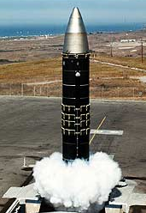
The Arms Race: A “Missile Gap?”
The Soviet Union exploded its first A-bomb in 1949.
Now there were two nuclear superpowers!
http://www.youtube.com/watch?v=IKqXu-5jw60

Slide 4
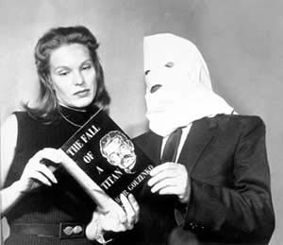
The Cold War in Canada
1945: Igor Gouzenko
(worker in Soviet embassy in Ottawa) revealed a Soviet spy ring in the Canadian government
►Not as much paranoia as in the USA
- Can. government refused to outlaw communism
►Distrust of communism in some areas
- Labour union leaders often suspected; RCMP monitored suspected communists
►Quebec: Premier Duplessis anti-communist
- Padlock Law: used to lock up buildings/ organizations suspected of being used by communists

Slide 5
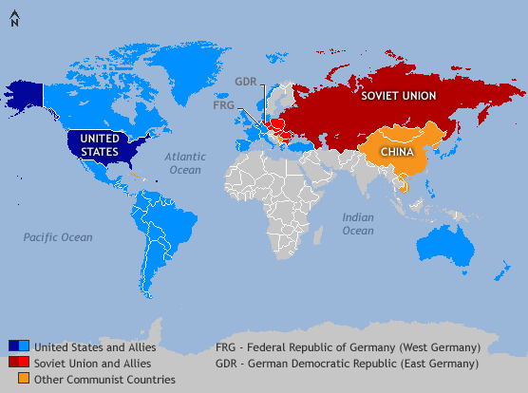
The Cold War World

Slide 6
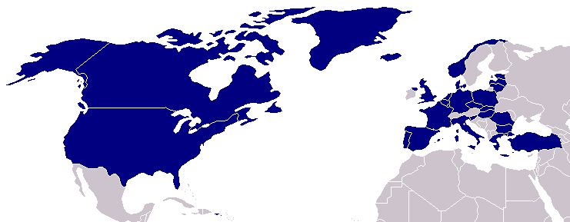
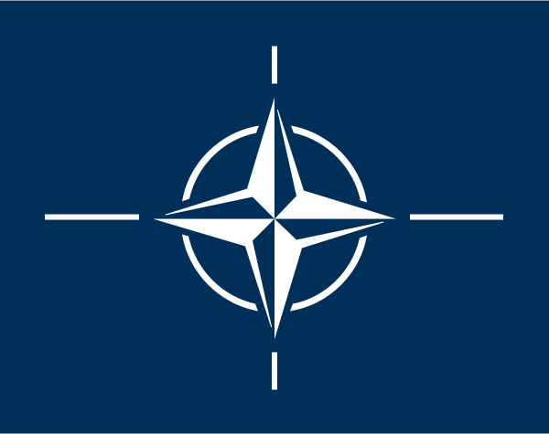
North Atlantic Treaty Organization (1949)
United States
Belgium
Britain
Canada
Denmark
France
Iceland
Italy
Luxemburg
Netherlands
Norway
Portugal
1952: Greece & Turkey
1955: West Germany
1983: Spain

Slide 7
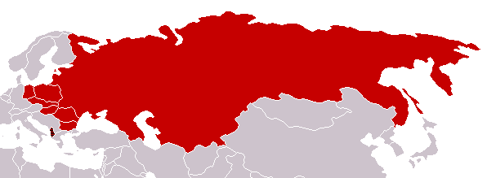
Warsaw Pact (1955)
U. S. S. R.
Albania
Bulgaria
Czechoslovakia
East Germany
Hungary
Poland
Rumania

Slide 8
NATO and The Warsaw Pact
This relationship would become known as the Cold War and would manifest itself in battles in Korea, Vietnam, Egypt, and Cuba.
Defensive posturing would result in the creation of the North Atlantic Treaty Organization of democratic countries and the Warsaw Pact, an alliance of communist countries.
The hope of N.A.T.O. was to stop or limit the spread of communism, the “red menace”.

Slide 9
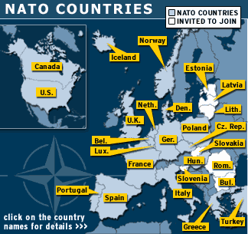
MAP: Countries of the NATO Alliance

Slide 10
Korean Conflict
World War II left the Asian country of Korea divided.
north was a communist state, supported by the USSR and communist China.
south was a fragile democracy backed by the United States.
1950 – war broke out as North Korea tried to invade South Korea.
A UN force, mostly Americans, tried to force the invaders to retreat; Canada sent thousands of troops and 3 naval destroyers to Korea.
At UN, Lester Pearson, Canada’s Minister of External Affairs, urged all sides to agree to a ceasefire.
U.S. considered using the atomic bomb; ceasefire reached in 1953.

Slide 11
Suez Canal
Suez Canal links the Mediterranean and Red Seas, and provides the shortest sea route from Europe to the Indian Ocean. It was privately owned by British and French investors.

Slide 12
Suez Crisis
1956 – Egypt’s president, Gamal Abdel Nasser, on behalf of the Egyptian government took over the canal.
The neighbouring state of Israel was frightened by what it saw as Egyptian aggression, as Egypt threatened to bar ships to and from Israel from using the canal.
Britain and France supported an Israeli invasion and, ignoring a UN Security Council resolution to end hostilities, they landed troops in the canal zone.

Slide 13
Suez Crisis (Cont)
Soviet Union immediately offered Egypt financial aid and missiles.
The U.S. was angry at its allies, Britain, France, and Israel, who had not consulted the U.S. government before attacking Egypt, but the U.S. still threatened retaliation against any Soviet involvement.
Conservative Party & many other Cdns felt duty to support Britain.
Lib PM Louis St. Laurent denounced the British and French intervention and refused to support them.
Lester Pearson proposed that a United Nations Emergency Force be sent to the Suez Canal to separate and mediate between the rival armies.
The force, under the command of a Canadian general, was chosen from countries not directly involved in the conflict.
For his efforts in defusing the crisis, Lester Pearson was awarded Nobel Peace Prize.

Slide 14
The Vietnam War
Canada did not participate in the Vietnam War although some Canadian weapons companies provided equipment to the U.S. military.
Many Canadians were unimpressed with the killing of civilians by American troops.

Slide 15
Vietnam War
Vietnam was divided into 2:
north was communist-controlled.
government of the south, (more a dictatorship than a democracy), was supported by the United States.
Americans felt that if the south fell to communism, then other Asian states would fall, one after another, like a set of dominoes.
by the 1960s it was sending U.S. troops as well.
By 1966, there were 190 000 U.S. soldiers in Vietnam, and number growing.
At the same time, the USSR and communist China supplied weapons and help to North Vietnam.

Slide 16
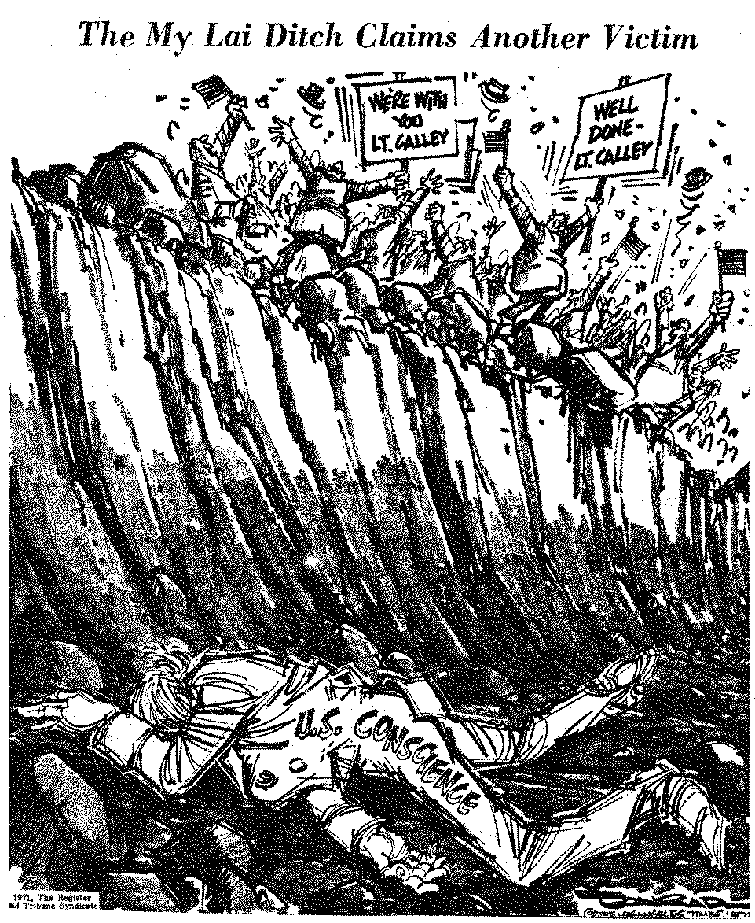
Vietnam War (cont)
first war recorded by tv cameras - watched Vietnamese villages being bombed - young men returning home disabled or in body bags – began questioning American involvement
1969 – new Pres Nixon, pledged to pull U.S. troops out of SE Asia – last left S. Vietnam in 1973.
Less than 2 years later, a North Vietnamese crushed the South Vietnamese army. Vietnam was unified under communist rule.
Many anti-communist Vietnamese fled in crowded boats and made their way to refugee camps in Malaysia and Hong Kong, where they applied for refugee status. -1000’s accepted in Canada.

Slide 17
Canada’s Reaction to the War
Canadians were at first divided over the war in Vietnam.
Canadian firms sold goods such as berets, boots, airplane engines, and explosives to U.S. Defence Department.
Most saw communism as a real threat to Western security.
But not sure peasants of Vietnam were “better dead than Red.”
1965 – PM Pearson criticized Operation Rolling Thunder – U.S. bombing campaign of North Vietnam – in a speech at a university in Philadelphia - then appeared at the White House the next day to confront a livid Johnson.
According to Lawrence Martin in his book The Presidents and the Prime Ministers, author Lawrence, LBJ grabbed Pearson by the shirt collar, lifted the prime minister off the floor and shouted, "You pissed on my rug!"

Slide 18
Towards a More Independent Defence Policy
Military apprehension would lead Canada to closer ties with the U.S.A (and decreasing association with Great Britain).
Canada would commit to the N.O.R.A.D agreement in 1957, a combined defensive effort of North America by combined Canadian and American efforts (mostly American).

Slide 19
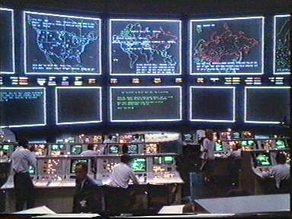
NORAD Headquarters Colorado

Slide 20
Towards a More Independent Defence Policy
The Americans would install three “warning systems” throughout Canada purposed to intercept inter-continental ballistic missiles that if launched would travel over Canada on their way to either the U.S.A. or Russia.
Canada would keep an army brigade and several air squadrons in Europe and Canadians ships and planes would track Russian submarines.

Slide 21
North American Defence
USA constructs three lines of radar stations across Canada, Alaska, Arctic in 1950s, each getting further north
- Pinetree Line, Mid-Canada Line, Distant Early Warning (DEW) Line
To detect a surprise Soviet attack, give USA time to intercept attack, launch counterattack
USA military personnel stationed in Canada
Reduced Canada’s independence?
Possible loss of independence worth greater security?

Slide 22
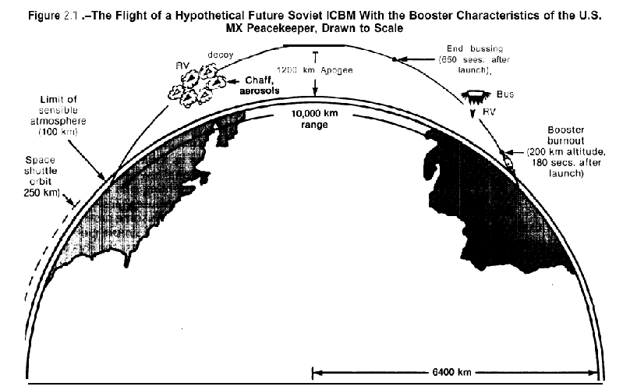
Planned Route of ICBM’s

Slide 23
Towards a More Independent Defence Policy
The Canadian government would develop civil defence plans for citizens and those more fearful, would construct “bomb shelters”.
Canadians would also become more conscious of “communist” ideologies and sympathies.
Defence industries “screened” their workers and unions were eyed with a “watchful eye”.

Slide 24
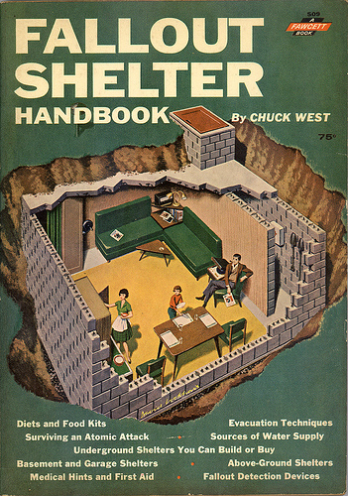
1950’s Fallout Shelter Handbook

Slide 25
Towards a More Independent Defence Policy
The situation in Canada did not parallel the American intensity. Senator McCarthy initiated a “witch-hunt” in the U.S.A. for communists and communists sympathizers with his House Committee on Un-American Activities.
McCarthy’s persecution of many innocent Americans through this commission would ruin many of their lives.
Why was he able to do this? http://www.youtube.com/watch?v=BIkU4MMQZ54

Slide 26
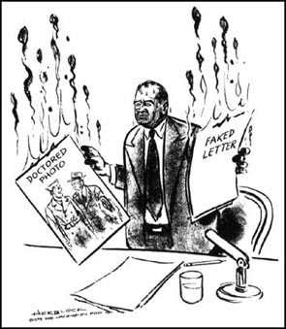
CARTOON: Senator Joseph McCarthy
What is the cartoon about?
What is the cartoon suggesting about the evidence McCarthy is presenting?
What does the cartoon suggest might happen to McCarthy’s future?

Slide 27
The Nuclear Issue in Canada
In the 1960’s tensions existed between the presidents of the U.S.A. and Canadian prime ministers, probably a result of a lack of total commitment by Canada to U.S. defence efforts.
Both Prime Ministers Diefenbaker and Pearson would have confrontations with Presidents Kennedy and Johnson.
Canada was hesitant during the Cuban missile crisis and Pearson was hesitant to allow nuclear warheads on American missiles on Canadian soil.

Slide 28
Cuban Missile Crisis
1959 –under the leadership of Fidel Castro, Cuban rebels overthrew Cuba’s pro-U.S. leader in a revolution.
U.S. imposes trade and economic sanctions on Cuba.
1961 – U.S. backed invasion of Cuba by a group of anti-Castro Cubans - invasion failed, but it encouraged Cuba to turn to the USSR for support.
1962 – U.S. planes took photographs showing that the USSR was installing offensive nuclear missile bases in Cuba.
Pres Kennedy announced a naval and air blockade of Cuba - U.S. forces and NORAD readied for war – world on the brink of war.
Soviet Premier Nikita Kruschev at first refused to remove the missiles - Soviet armed forces were put on full alert and Soviet ships were mobilized.

Slide 29
Cuban Missile Crisis (cont)
last minute, Kruschev agreed to dismantle the missile bases in exchange for a promise that the U.S. would not invade Cuba – US wins game of “nuclear chicken.”
PM Diefenbaker was reluctant to have Canada drawn into a major conflict that seemed largely rooted in U.S. policy and interests.
At first, the Canadian government refused to place Canada’s NORAD forces on alert. Nor did it allow U.S. planes with atomic weapons to land at Canadian bases.
A poll later showed that 80% of Canadians even thought Diefenbaker was wrong. Eventually Diefenbaker did put Canadian troops on alert, but damage to Canada-U.S relations had already been done.
Cuban Missile Crisis: http://www.history.com/videos/cuban-missile-crisis#kennedy-and-the-cuban-missile-crisis

Slide 30
The Avro Arrow
A shining moment occurred with the development of the Avro Arrow, a supersonic jet fighter.
It was well ahead of its time technologically but would be scrapped by the Diefenbaker government who maintained modern day warfare would be fought with intercontinental missiles rather than jet fighters.

Slide 31
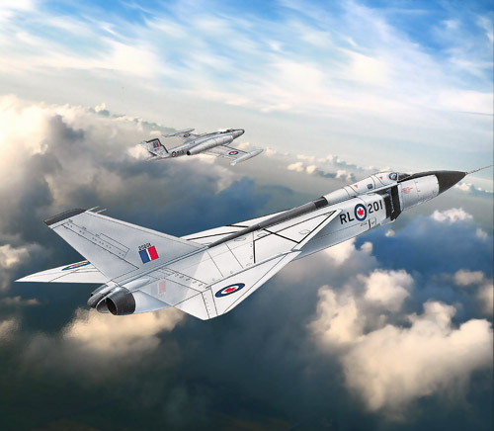
The AVRO Arrow

Slide 32
The Avro Arrow
It was also a Liberal inspired project and Diefenbaker was a Conservative.
Popular Belief: US military jealous of advanced Arrow, convince PM Diefenbaker to cancel project
Historians: Arrow was way too costly, Canada could not afford it, other countries didn’t want to buy it
It is ironic that most of the world’s minor conflicts since then have utilized jet fighters almost exclusively.

