Slide 1
Canada in 1970’s
I. Economic Challenges
II. Regionalism
III. Canada-American Relations
IV. Canadian Foreign Policy
V. Social Issue – do the Hustle
A. Women
B. Immigration
C. Multiculturalism
VI. Trudeaumania

Slide 2
The 1970’s - Can you dig it?
Disco, polyester, and John Travolta
I give you, the iconic Saturday Night Fever

Slide 3
I. Economic Challenges
Trudeau era begins with Canada enjoying two decades of economic growth – many thought it would never end—till it did.

Slide 4
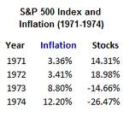
A. Economic crisis
1. Inflation – huge increase in oil prices ups it – more costly to produce items, dollar has less buying power
-Trudeau imposed price and wage controls (contributed to inflation)
-hit double-digits (usually 2-4%)– today?
-prices rise = demand for higher wages= increases in prices=businesses failing
-unemployment began to rise (3-5% in 50’s-60’s to high of 12% by 1983) today?
-dual-income families became common – need two bread winners to keep up
-by 1978’s family’s buying power fell for first time since end of WWII
February 2013- 1.2%
7.2% in March

Slide 5
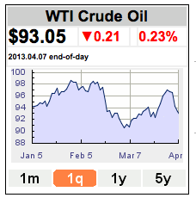
A. Economic crisis
2. Oil embargo – 1973 by OPEC (Organization of Petroleum Exporting Countries).
-War btw Israel and Arab neighbours – western countries (including Can, support Israel) – oil-producing countries retaliate—refuse to sell oil to them
-oil and gas prices jump 400% (from $6 US to $16 US a barrel) – by 1979, Iran/Iraq War hits: $40 - today?
The Oil Shortage
1978. Cheap at 97.9 cents ... In Britain it's $2.65 (1 gal = 3.785 L)
Read more: http://www.ottawacitizen.com/cars/Gallery+Prices+from+1970s+1990s/6366833/story.html#ixzz2PogBEJlW

Slide 6
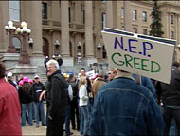
II. Regionalism
Western alienation:
1. National Energy Program – response to OPEC crisis
-Froze Alberta oil prices below world level to keep price low for Cdns
-Trudeau imposed tariffs on oil sold to US (would use tax to subsidize oil in East)
-Infuriated Albertans – people begin talk of separating from East
-program provided funding to Cdn oil companies to drill in Arctic & off coast of Newfoundland & encourage consumers to switch from oil to gas & electric
-oil prices fell again in 1984 – NEP dismantled – bitterness lingered

Slide 7
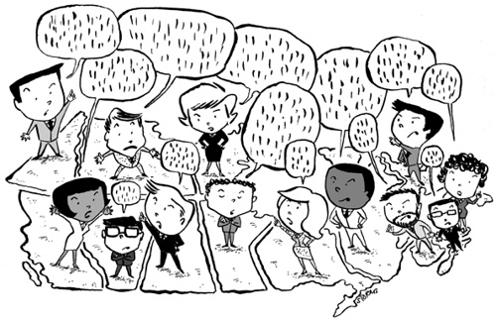
Regional disparity
Economic gap between have and have not regionals highlighted by 1970’s recession
Fishing industry in Atlantic Can., forestry, mining, fishing in BC – massive layoffs
Ont and Quebec less affected

Slide 8
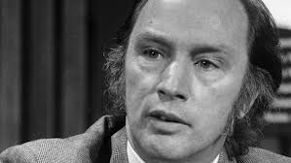
Canada – us relations
Living next to you is in some ways like sleeping with an elephant. No matter how friendly and even-tempered is the beast, if I can call it that, one is affected by every twitch and grunt. - Trudeau

Slide 9
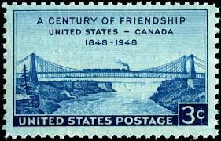
III. Canada-American Relations
Economic ties
-Auto Pact (US branch plants in Can)
-70% of all Cdn products sold to US – dependence on sales cause for concern
FIRA (Foreign Investment Review Agency)
-1973, to approve any new foreign companies in Can (targeted Amer investment)

Slide 10
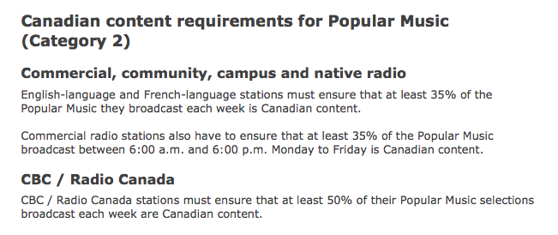
B. Entertainment Industries
Amer music, TV & radio bombards Can (one of most popular and controversial tv shows was All in the Family
promote film industry & tax credits for Cdn books and mags
Cdn radio & TV stations require to air % of Cdn content – what is it today?

Slide 11
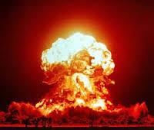
Nuclear Issue
NORAD – involvement maintained
Bomarc Missiles & their nuclear warheads stationed in Can – removed by 1971
Trudeau hoped that scaling back Can participation in nuke race with USSR would ease Cold War tensions
SALT I
Meanwhile, US and USSR talked in 1972 at Strategic Arms Limitation Talks & signed Anti-Ballistic Missile Treaty to reduce number of nukes = breakthrough
In 1979, Soviets invade Afghanistan, sent medium-range missiles to East Euro
NATO responds with more advance missiles in Euro
Western nations boycott 1980 Olympics in Moscow

Slide 12
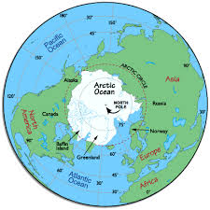
Sovereignty in Arctic
Northwest Passage & Arctic islands – claimed by Can
1968, with discovery of Alaskan oil, tanker traffic initially travelled w/o Can approval
Govt extended Can’s territorial limits to 19 km offshore and passed legislation to protect ecosystem – oil companies agreed
“Law of Sea Convention” from UN conference 160 nations acting together to protect oceans – oil companies active in sensitive areas pay special tax

Slide 13
IV. Canadian Foreign Policy
A. Cdns question Amer influence = find new trading partners
1. Recognition of Communist China - Can acknowledged Chinese Communist government before US did
-some right wing Amers. Accused Trudeau of being communist
2. NATO -Trudeau reduced by half # of Cdn armed forces station in Euro
-1970-72 – gave up nuclear missiles in Euro
3. Foreign aid
-La Francophonie=gave more aid to former French colonies
-CIDA – (tied aid – countries would use aid to buy Cdn products)
4. Trade
-increased trade to Asian countries and allowed more Asian immigrants
-increased trade and poli ties with Cuba and Mexico
-1971, Trudeau visited USSR
5. Refugees -Can accepted refugees fleeing communist regimes after uprisings in Hungary in 1956, Czech in 1968, South Vietnamese (Boat People) in 1975
6. Trudeau’s aim: to bridge econo gap separated rich North and poor South in order to promote world peace

Slide 14
V. Social Issue – do the Hustle A. Women
1. Legislative Changes
-discrimination again women illegal
-1976, mat leave (women temporary leave job after having baby w/o losing job)
-1977- equal pay for work of equal value
-1978, subsidized daycare and child tax credit
2. Women in Govt
-Jeanne Sauve – first women Speak of HofC in 1978 – became GG in 1984
-females also apt to Supreme Court of Canada
3. In the Workforce
-1970, 35% of women employed outside the home, by 1980, 48%
-entering traditional male careers: lawyers, doctors, plumber, mechanics
-men still held top jobs and sometimes paid more for equal work
4. NAC (National Action Committee on Status of Women)
-in 1972, united many women’s groups as united voice – pressure group lobbied govt
-responsible for inclusion of Charter clause guaranteeing equality of women

Slide 15
Immigration
1. Citizenship Act of 1976
-eliminated gender discrimination
-granted citizenship to children of overseas marriages when mother was Cdn (only fathers before)
-required adequate knowledge of one of two official languages to become citizen
2. Immigration Act of 1978
- reduced barriers to immigration
-Quebec ability to ensure new immigrants would adapt to francophone culture
-three categories of immigrants: family class (relatives sponsored in), refugees and independents (seeking improved living conditions)

Slide 16
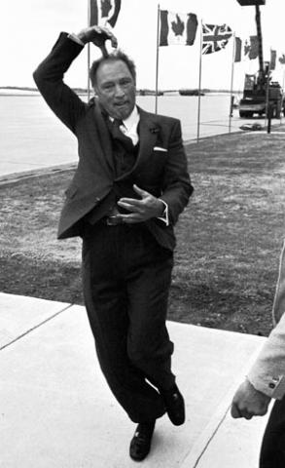
VI. Trudeaumania
Charismatic lawyer and scholar
Drove sports car, dated celebrities, went to NY nightclubs, swarmed by admirers at public appearances
“Just society” – believed that govt had a duty to protect rights and freedoms of people & foster their economic and social well-being
Personal liberties – govt must stay out of the bedrooms of the nation
Official Languages Act in 1969 – made Can bilingual/bicultural (make Que feel part of Canada) – not so much (we’ll get back to this)
Love him or hate him, Trudeau and his policies dominated the 70’s and left a permanent stamp on Canada

