Slide 1
Canada’s Response to the War
War Begins
Ch. 5 (p. 127-132)

Slide 2
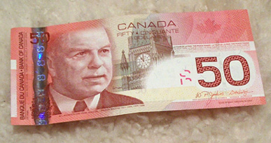
Canada’s Policy of Isolationism
-1930s: Canada is isolationist
Focused on Canadian issues, not situation in Europe
Supported appeasement
Did not want another war
Conscription bad for English-French relations
Economy starting to improve, war expensive
-1937: PM King met with Hitler
King believed Hitler peaceful,
in fact…

Slide 3
King Visits Nazi Germany 1937
Met with Hitler
Only North American leader to do so

Slide 4
King commented in his journal
"he is really one who truly loves his fellow-men, and his country, and would make any sacrifice for their good".
He forecast that: "the world will yet come to see a very great man–mystic in Hitler. [...] I cannot abide in Nazism -– the regimentation -– cruelty -– oppression of Jews -– attitude towards religion, etc., but Hitler, him –- the peasant -– will rank some day with Joan of Arc among the deliverers of his people."

Slide 5
Even Time Made Hitler Man of Year 1938
To be fair, TIME had a point in recognizing Hitler as the person who, “for better or for worse … [had] done the most to influence the events of [1938].

Slide 6
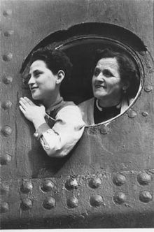
Jewish Refugees
Jewish refugees not allowed
into Canada
Knew Germany discriminating against Jews
Didn’t know about concentration camps yet
Not enough jobs in Canada
Jewish refugees not Canada’s problem
Immigration director: “None is too many”
Much anti-Semitism in Canada

Slide 7
SS St. Louis
SS St. Louis(1939)–ship with 907 Jewish refugees not allowed to dock in Canada or USA
Had to turn back to Europe, est. 1/4 passengers eventually sent to concentration camps

Slide 8
Canadians Speak Out
Many Canadians disagree with government’s anti-Semitism
Protests against anti-Semitism in some cities
1938: 150,000 Jewish people living in Canada
PM King urged to let Jewish refugees in, but resisted
1933-1945: Only 5000 Jewish refugees allowed into Canada
Much fewer than other countries
By 1939: 95,000 Jewish refugees to USA, 40,000 to

Slide 9
War Declared
Sept. 1, 1939 –Germany invades Poland
Sept. 3, 1939 –Britain and France declare war on Germany
Canada not automatically included this time
Sept. 10, 1939 –Canada declares war on Germany after a vote in Parliament
Canada exerting newfound autonomy
Different from Canada’s entrance into WWI
PM King promises no conscription as long as he’s PM
Gains support of French-Canadians
Only the CCF vote against declaring war

Slide 10
Mobilizing Canada’s Resources
Military not prepared for war
Few soldiers, equipment
Canadians not as enthusiastic compared to 1914
Remembered horrors of WWI
Beaten down by Great Depression
Many volunteers, though (~60,000 in first month)
Paid (relatively) well, received allowances for family
Still strong attachment to Britain
New Canadian patriotism
Women allowed to enlist, but only in non-combat roles

Slide 11
Horror of WWI
How many Canadian military personnel died?
66,665

Slide 12
Great Depression
-Between 1929 and 1939, the gross national product dropped 40%
-Unemployment reached 27% at the depth of the Depression in 1933.
-Many businesses closed, as corporate profits of $398 million in 1929 turned into losses of $98 million as prices fell.
-Farmers in the Prairies were especially hard hit by the collapse of wheat prices.

Slide 13
Mobilizing Canada’s Resources

Slide 14
Mobilizing Canada’s Resources

Slide 15
British Commonwealth Air Training Plan (BCATP)
British instructors train Allied pilots and other air force personnel in Canada
Away from battle, lots of space, Europe-like climate
Over 200 locations across Canada
Trained over 130,000 personnel
PM King hoped to keep volunteers in Canada, reduce need for conscription
Over 70,000 Canadian graduates of BCATP served in Europe

Slide 16
British Commonwealth Air Training Plan (BCATP)

Slide 17
Total War
Government organized Canada and its resources to do whatever it could to win the war
Established Department of Munitions and Supply
C.D. Howe minister of department
Ran wartime economy in Canada
Told industry what to produce, how much
Industries making products they’d never made before
Crown Corporations produce goods private businesses unable to
Farmers told what to produce
Rationing -gasoline, silk (parachutes), food (1942)

Slide 18
Why save fat?
The fat that came from cooking could be used for making explosives.
Housewives were reminded that glycerin, made from waste fats and greases, was one of the most critical materials needed for the war effort. 3lbs of fat could provide enough glycerin to make 1lb of gunpowder. Nearly 350 pounds of fat was needed to fire one shell from a 12-inch Naval gun.

