Slide 1
Causes of the Great Depression
Ch. 4 (p. 90-93)

Slide 2
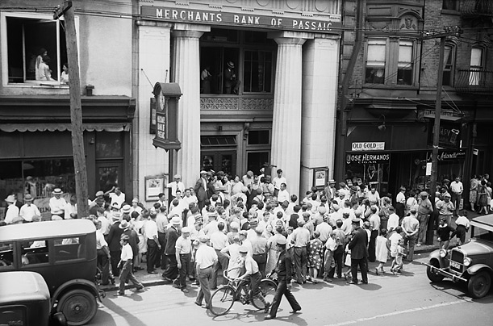
Stock Market Crash
The stock market crash in October 1929 marked the beginning of the Great Depression

Slide 4
Trading Floor As the slide continued, trading increased. the panic, clerks worked for 48 straight hours.

Slide 5
Supply and Demand
Supply -how much of a product is available to buy
Demand -how much people want to buy a certain product
Low supply = High demand
↑ Prices
High supply = Low demand
↓ Prices

Slide 6
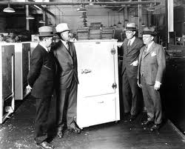
Causes: Overproduction
Economy booming in 1920s, business increase production
Supply becomes greater than Demand
Businesses slow down
production, lay off workers
Workers have less money
to spend, economy
slows down further

Slide 7
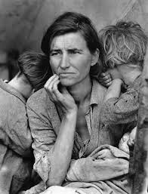
Economic Dependence on Exports
Canadian economy heavily reliant on several specific products
Wheat, fish, minerals, pulp & paper
Other countries begin to sell these products too
High Supply = lower prices
Canadian industries suffer
Also, severe droughts on the Prairies
Crops fail, farmers go bankrupt

Slide 8
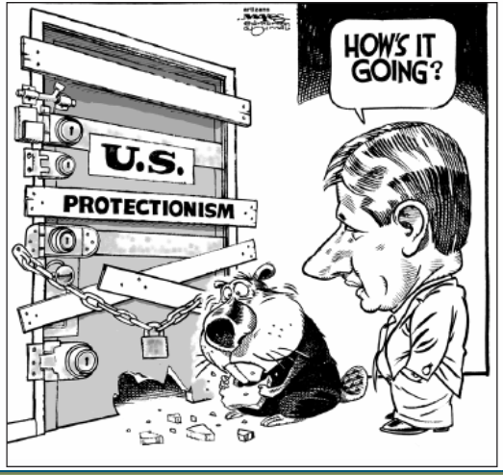
Tariffs and US Protectionism
Canada’s economy increasingly dependent on US economy
Much of Canadian industry owned by American businesses
US factories shut down, unemployment rises
Demand for Canadian products decreases
Canadian economy suffers

Slide 9
Tariffs and US Protectionism
World economy slows down, countries (incl. USA) place tariffs on imported goods (Protectionism)
Tariffs = taxes on imported goods
Protectionism = Tariffs used to raise price of imported goods in order to protect domestic producers
Tariffs make Canadian products more expensive in USA and other countries, harder to sell
Canadian economy suffers

Slide 10
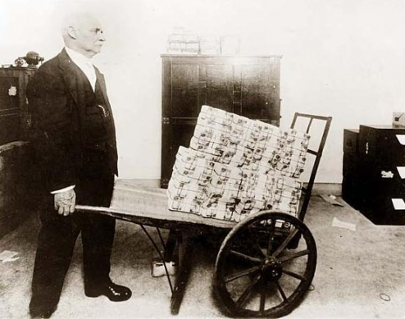
Debt From First World War
Germany to pay huge reparations to Britain and France
-$300-400 billion (2011 dollars)
Germany unable to make payments to Britain and France
Britain and France unable to pay off debts to United States
Other countries cannot pay back US because of slowing trade (tariffs)
Bad for US economy

Slide 11
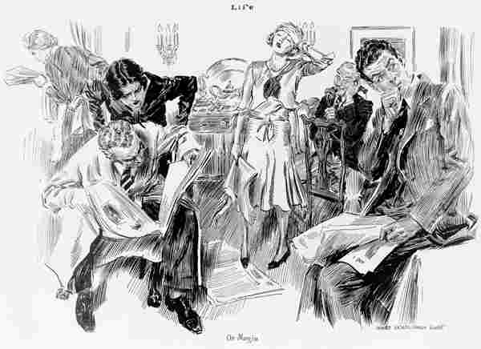
Speculation and the Crash
Economy booming in
1920s, Canadians start to
purchase items on credit
“buy now, pay later”
When economy slowed, people lost jobs, unable to make payments, lost possessions
Canadians buy stocks “on margin”
Make small down payment (around 10%), borrow the rest
Called “speculators”

Slide 12
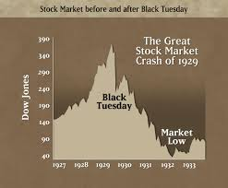
Speculation and the Crash
Hope to make a quick profit
when the stock prices go up,
repay loans
Stocks = small shares of ownership in a company (company does well, stock prices ↑)
Stock Market Crash
Investors start selling stocks to cash in on high prices, others follow their lead
Stock prices drop, people panic = crash
Speculators left with worthless stocks and big loans to pay off

