Slide 1
Dieppe

Slide 2
The Dieppe Raid
1942: Soviet Union struggling to defend itself against the German invasion
Want Allies to invade Europe, make Germany split its forces
Allies not ready for full invasion, but try trial run; test techniques, equipment, info
Plan to invade French port city of Dieppe
August 19, 1942
First major Canadian battle in WWII

Slide 3
The Dieppe Raid
Plan: series of attacks along coast in the middle of the night, then main attack on town
Ship on way to Dieppe discovered by German convoy
Allies lost element of surprise, Germans ready
Weather delayed Allied arrival until dawn
Lost cover of darkness, easily seen by Germans
Poor communication between ships and troops on land, reinforcements sent too early
Tanks got stuck on beaches

Slide 4
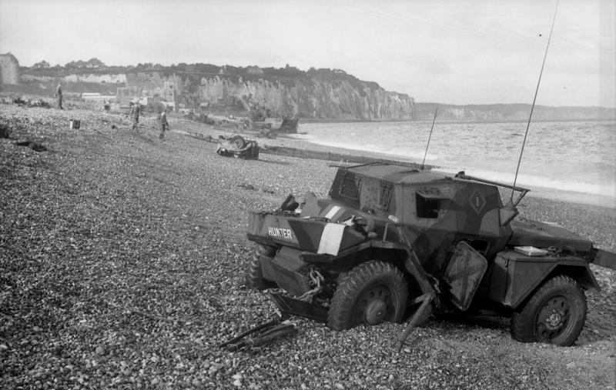
The Dieppe Raid

Slide 5
The Dieppe Raid

Slide 6
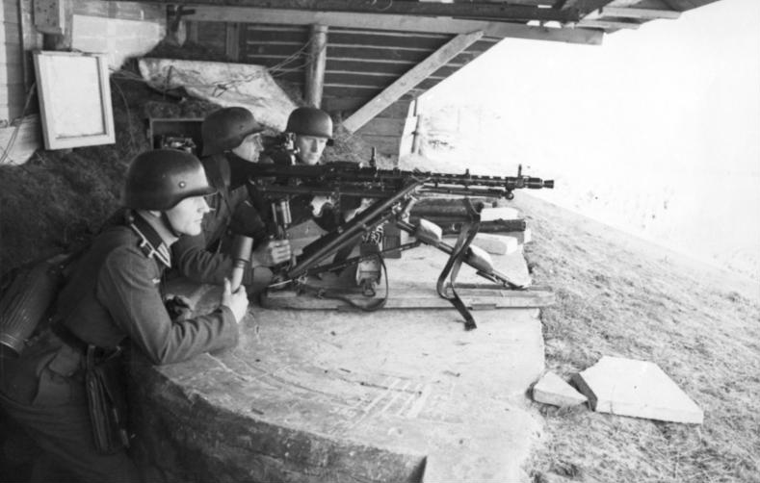
The Dieppe Raid

Slide 7
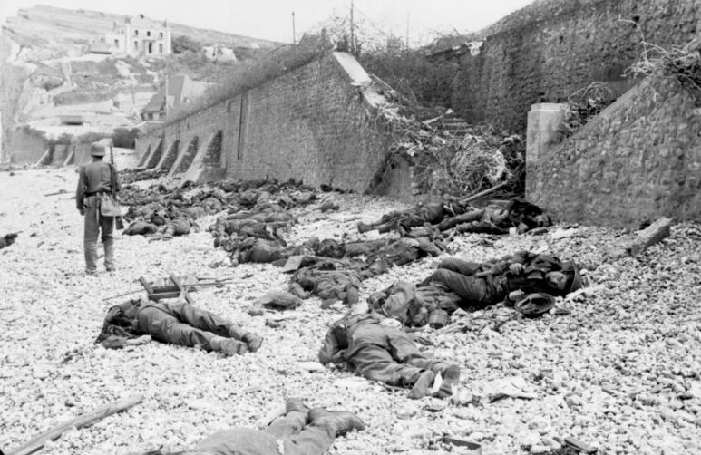
The Dieppe Raid

Slide 8
The Dieppe Raid
Approx. 5000 Canadians took part
907 killed, 586 wounded, 1946 taken prisoner
Was it worth it?
No: a complete disaster without value, taught Germans more than Allies
Yes: a valuable lesson, led to success of D-Day invasion in 1944

