Slide 1
Economic Crash
Ch. 3 (p. 63, 66, 85)

Slide 2
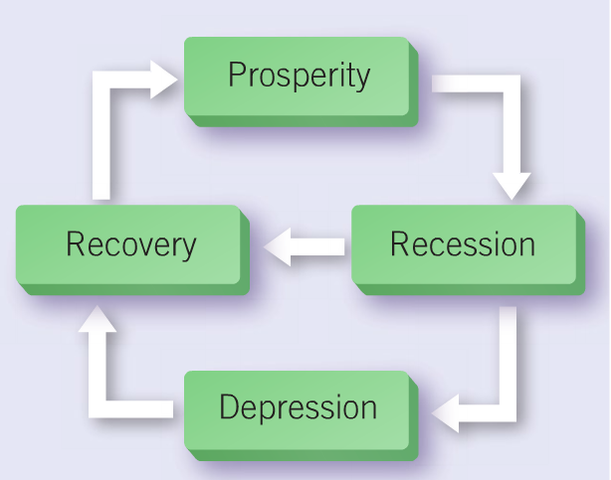
Economic Cycle

Slide 3
Economic Cycle
Different stages that an economy can go
Prosperity – economy booming, income levels high, unemployment low
People spending a lot of money, possibly leading to inflation
aka “Boom”
Recession – production low, unemployment high
People have less money, spending little, economy slows down
aka “Bust”
- Depression – severe recession, mass unemployment and poverty
Recovery – demand for goods increases, more jobs, higher incomes, economy improves
Prosperity again

Slide 4
1920s Economy
Post-WWI to early 1920s – factories closing down, veterans returning looking for jobs, high unemployment, low spending
Recession

Slide 5
1920s Economy
Early to mid-1920s - economy improved (natural resources and manufacturing)
manufacturing (factories) brought many people to cities
urbanization = movement of people from rural Canada (country, farms) to urban Canada (cities)
industry often located in downtowns, not nice places to live
created slums/pollution; wealthy moved away from downtown

Slide 6
1920s Economy
United States replaces Britain as most important trading partner (after WWI, Britain in debt and US wealthy)
US companies invest heavily in Canada, export goods to US
US companies build branch plants in Canada (ex. auto industry)
Branch Plant = factory/office set up in Canada, but owned or controlled by foreign companies
by end of 1920s US companies own large proportion of Canadian industries (oil, machinery, chemical, rubber, and electrical industries)
Pumped money into Canadian economy, but US benefited the most
Recovery to Prosperity

Slide 7
Also during 1920s - Prohibition in Canadian provinces (WWI to early 1920s) o prohibition = sale and consumption of alcohol prohibited
prohibition pushed by temperance movement, primarily women
soldiers returned, prohibition unpopular, laws repealed early 1920s
replaced with government controlled liquor stores
national prohibition in United States 1919-1933
large bootlegging industry in Canada
bootlegging = importing alcohol illegally into US and/or making it yourself to sell
extremely profitable, but dangerous
often controlled by organized crime (Al Capone, Mafia)
“rum-runners” smuggled alcohol across the border to US
sometimes caught by US Customs or were killed

Slide 8
Tuesday, October 29, 1929 - “Black Tuesday”
New York Stock Exchange collapsed (economic disaster)
stock market crash = prices of all stocks fall sharply and quickly
Canada goes from Prosperity straight to Depression
End of Roaring Twenties, beginning of the Great Depression

