Slide 1
Global Warming
Ch. 13 (p. 438-443)

Slide 2
What is Global Warming?
Definition: the gradual rise in the average surface temperature of the Earth
Some regions are warming more quickly than others
Some have even cooled slightly
As a result, the term “climate change” is gradually replacing “global warming”

Slide 3
Is the World Getting Warmer?
Earth has warmed ~0.74C in the past 100 years
The 2000s was the warmest decade on record, and the 1990s was the second warmest
Detailed temperature records have been taken since the mid-1800s
Earlier historical temperatures are less accurate
Based upon tree rings, ice-core samples

Slide 4
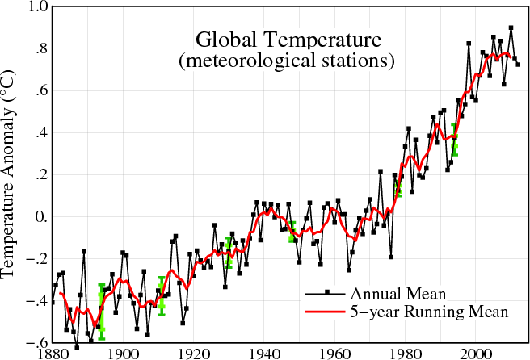
According to NASA: http://data.giss.nasa.gov/gistemp/graphs_v3/

Slide 6
What Causes Global Warming?
Some debate over this question
The Greenhouse Effect is generally accepted as the major cause of global warming p. 439
Greenhouse gases: carbon dioxide (CO2), methane (CH4), and nitrous oxide (N2O)
Greenhouse gas levels in the atmosphere have increased dramatically since the Industrial Revolution
CO2:271 ppm (pre-industrial average) –385 ppm (2008)

Slide 7
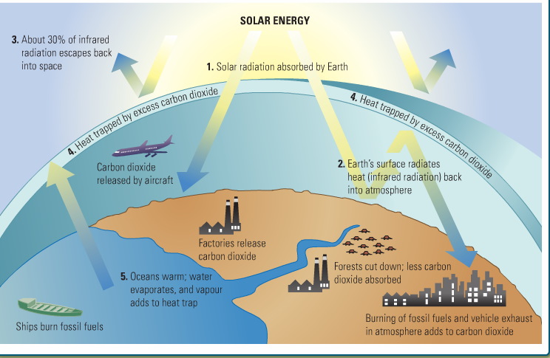

Slide 8
Where Do GHG Come From?
Some are naturally occurring
Carbon dioxide: the burning of fossil fuels (oil, coal, natural gas), fewer trees to absorb CO₂
Transportation, factories, electrical production, etc
Developed nations emit the most CO2 per capita
Methane: landfills and agriculture (er…cow farts, awkward)
Nitrous oxide: fertilizers
Methane and N₂O are more powerful heat-trappers, but there is far more CO₂ produced, so it has a larger effect on climate change

Slide 9
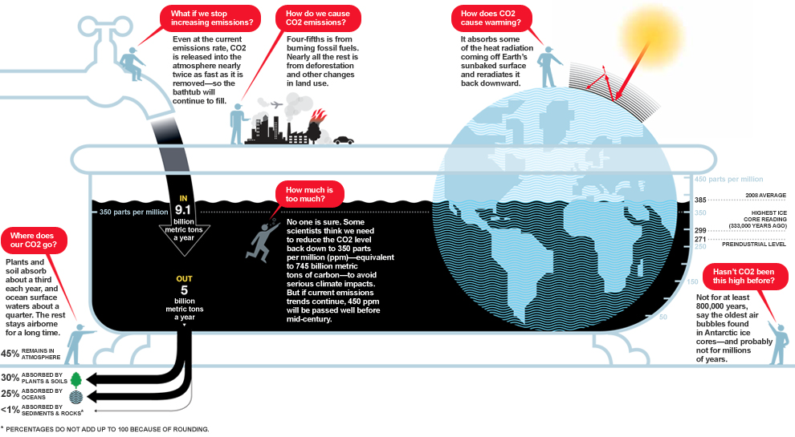
The carbon bath
http://ngm.nationalgeographic.com/big-idea/05/carbon-bath

Slide 10
The Carbon Bathtub
It’s simple, really:
As long as we pour CO₂ into the atmosphere faster than nature drains it out, the planet warms. And that extra carbon takes a long time to drain out of the tub.

Slide 11
What Are the Effects of GW?
Melting Ice: rising temperatures melt glaciers and ice sheets, leads to rising sea levels
Extreme Weather: more frequent and severe heat waves, droughts, wildfires/forest fires, floods, hurricanes and storms
Ecosystems: transformation and reduction of sensitive ecosystems, affects animal and plant life, leads to possible extinctions

Slide 12
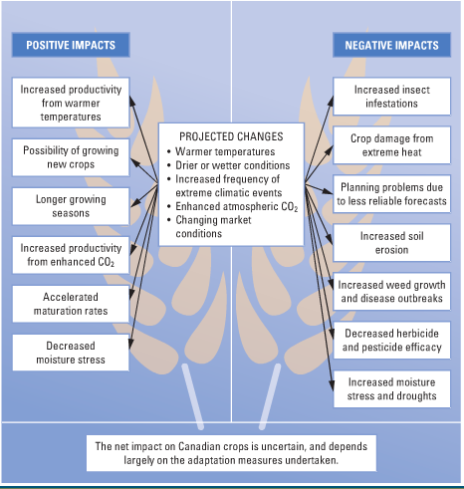
Page 442
Impact on Canadian
agriculture

Slide 13
Canada and Climate change
Warmer winters allow pine beetle to survive in BC
Arctic regions seeing sea ice shrinking
Seasonal melt occurring weeks earlier
Polar bears slowly starving bc can’t find ice to use to hunt seals
Arctic communities facing sinking shorelines bc permafrost (permanently frozen subsoil) is melting
Warmer weather brings more droughts making forest fires more likely
Raising sea-levels affect low-lying deltas like Fraser River and Mackenzie River
Effects of Global Warming

