Slide 1
Government Wrap Up

Slide 2
Party Discipline
Politicians in a party are “encouraged” to all vote the same way
Party Whip (one per party)
– An MP chosen to ensure members are present in Parliament and vote the party way (does not actually carry a whip)

Slide 3
Party Discipline
• If a party member acts against the party, the party leader can expel the member from the party
• Free Votes
– When party members are allowed to vote whichever way they want on legislation
– Usually on controversial issues • Ex. capital punishment and same-sex marriage

Slide 4
Minority vs. Majority Governments
• Majority government: the ruling party has more than half the seats in the legislature
– Ruling party can basically do what it wants – Ex. Conservatives in 1980s, Liberals in 1990s
• Minority government: the ruling party has fewer than half the seats in the legislature
– Ruling party needs to negotiate with opposition parties and compromise to get things done
– Ex. Current Conservative government

Slide 5
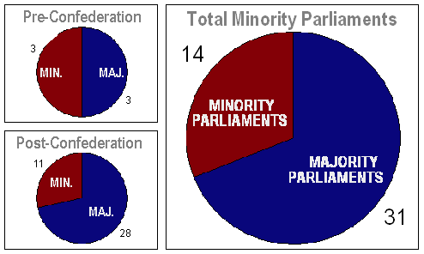
Minority vs. Majority Governments
Majority Gov. Advantages
^{– Stability}
^{- Consistency}
^{- Efficiency}
Minority Gov. Advantages
^{- Responsiveness}
^{– Accountability}
^{– Transparency}

Slide 6
Coalition Government
• An option in order to avoid a minority government is to form a coalition
– Alliance between two or more political parties
– Often hard to keep all parties involved happy
– Ex. Libs and Progressives formed a coalition government in the 1920s (did not last long)
• Another option is for parties to merge
– Ex. 2003 Canadian Alliance and Progressive Conservatives merged to become the Conservative Party (won the election)

Slide 7
^{Parliament Closed for Business}
Prorogue Parliament
– To temporarily suspend Parliament
– Can be used to protect the ruling party, stop legislation, or reorganize committees
– Ex. PM has prorogued government until October:
http://globalnews.ca/news/788947/harper-to-prorogue-parliament-until-october/
Official reason: Conservatives wanted time to consult with Canadians about the economy
Opposition response: considered proroguing undemocratic, allowed gov. to avoid difficult issues

Slide 8
Parliament Closed for Business
• Dissolve Parliament
– Done by Governor-General at PM’s request
– Parliament ends and an election is called
– Reasons to call an early election
- Vote of non-confidence in Parliament
– Ex. 2011 Conservative Party
-Ruling party wants to take advantage of its popularity or opponents’ weakness
– Ex. PM Chretien in 2000 when opposition not ready
- To test if the government has the support of the people
– Ex. PM Borden during WWI about conscription issue

Slide 9
Choosing the Government
• Voting Requirements – At least 18 years old and a Canadian citizen
• Election Basics
– Voters choose a representative (MP - Federal or MLA - provincial) for their area
– Each region that selects a representative is called an electoral district, riding, or constituency
• Mean the same thing
• Based on population (~100,000 people in each riding for a federal election)

Slide 10
Choosing the Government
Federal elections are held at least every 5 years - MPs
Provincialvelections at least every 4 years - MLAs
InvBC,vMunicipal elections are held every 3 years - City Councilors/ Mayor

Slide 11
Polling
During an election public opinion is constantly monitored
Polling companies contact voters and ask questions about political leaders, parties and issues
Results of polls go to parties and media
Campaigns altered to reflect public opinion
– Speeches
– Television appearances
– Debate responses
– Candidate appearance
Criticism of Polling: May dissuade people from voting for parties they think can’t win; may lead to knee-jerk reactions; shallow?

Slide 12
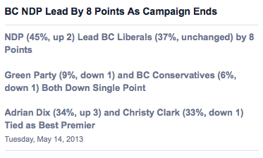
Polls don’t always get it right

Slide 13
Choosing the Government
• Stages of a Federal Election
Dissolution – Governor General dissolves Parliament, an election is called
Enumeration–National list of voters compiled
Nomination – Parties choose candidates
Campaigning–Vote for us, not them! Donate to my campaign fund!
Voting–Eligible voters cast their vote
Tabulating – Votes counted and winners declared

Slide 14
^{Electoral Systems}
First Past the Post (FPTP)
Canada’s electoral system
The candidate who has most votes in a riding wins - he/she can win by 1 vote
- Ex. Winner = Sally 2310 votes Loser = Ned 2309
Simple and straight forward
The more candidates that run, the fewer votes the winner must earn
The candidate does not have to have a majority of the votes to win (over 50%)
- Sally 51 votes, Ned 45, Gregory 32 – Sally wins

Slide 15
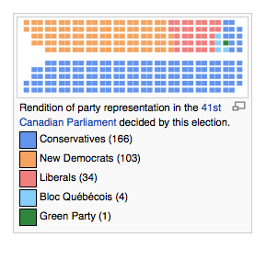
^{Electoral Systems}
Problems with First Past the Post
– Parties can control a government with less than half of the popular vote
– Much of the populations desires are not recognized in government
– Rewards parties that have strong support in certain regions, rather than spread evenly across the country

Slide 16
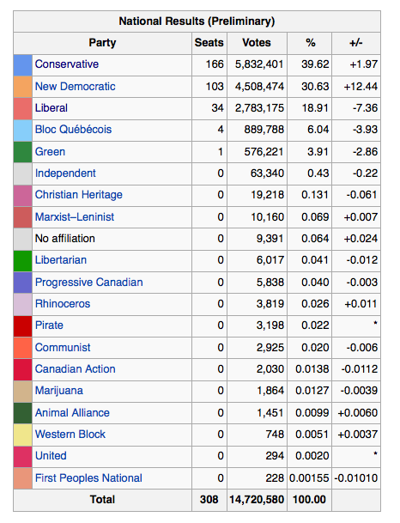
2011 Election results

Slide 17
Electoral Systems
• Proportional Representation
– An alternative system to FPTP
– Voters choose a political party instead of a candidate
• If a party receives 38% of the votes they in turn are allotted 38% of the seats
– There have been recent attempts to change BC’s electoral system to a version of proportional representation called Single Transferable Vote (STV)
• http://www.youtube.com/watch?v=y-4_yuK-K-k

Slide 18
Electoral Systems
• Problems with Proportional Representation
– Does not allow for local representation
• Representatives chosen from very large ridings, may all come from the same area in the riding
– Would lead to more minority governments
• Creates a need for coalitions or alliances • Can lead to political deadlock and inefficiency
– Not as easy to understand as FPTP
• STV is especially complicated

