Slide 1
Human Rights and the Charter
Ch. 10 (p. 324-334)

Slide 2
Human Rights Movement
Global concern for protection of human rights increased dramatically after Holocaust discovery
UN Universal Declaration of Human Rights
Drawn up by UN General Assembly in 1948
Outline of the rights to which all humans are entitled
Most UN countries (inc. Canada) have signed it
-We can make complaints to the UN Human Rights Committee if Canadian gov. isn’t meeting UN standards
No punishment for offending countries, though, just encouragement to follow the rules

Slide 3
Human Rights Movement
International Courts and Tribunals
1946: International Court of Justice (ICJ)
Settles disputes between countries
Can only get involved if both sides ask it for help
Temporary courts set up to deal with specific events
Nuremberg and Tokyo trials after WWII
War crimes tribunals for Kosovo, Yugoslavia, and Rwanda
2002: International Criminal Court (ICC)
Investigates and prosecutes war criminals and those guilty
of crimes against humanity - 114 countries are members (inc. Canada, but not US, China

Slide 4
Human Rights Law in Canada
Slowly began to expand after WWII
Asian-Canadians get right to vote in late-1940s
Still much discrimination and inequality, though
First Nations didn’t get right to vote until 1960
1960: Canadian Bill of Rights
Passed by PM Diefenbaker to protect human rights
Could be changed by Parliament, could be overruled by federal/provincial laws
Wouldn’t be until 1982 that human rights in Canada were solidly entrenched

Slide 5
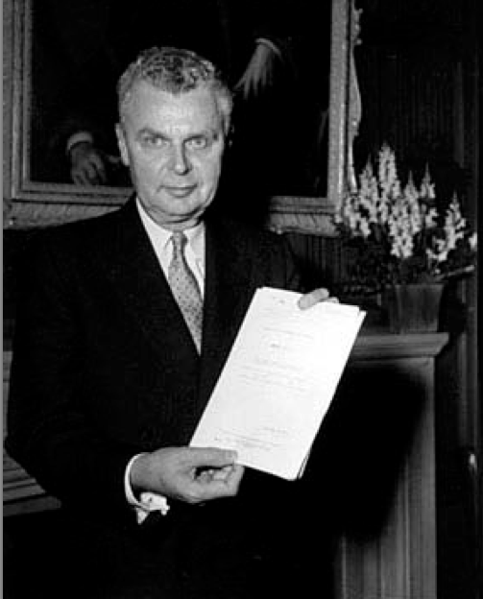
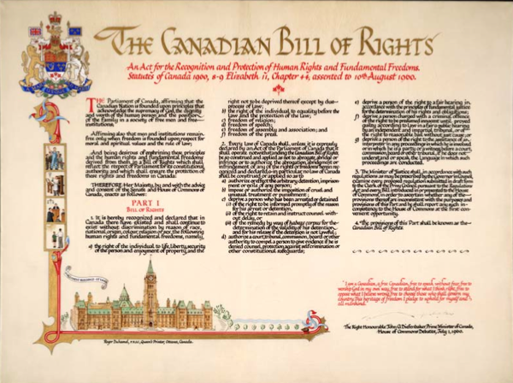
Canadian Bill of Rights

Slide 6
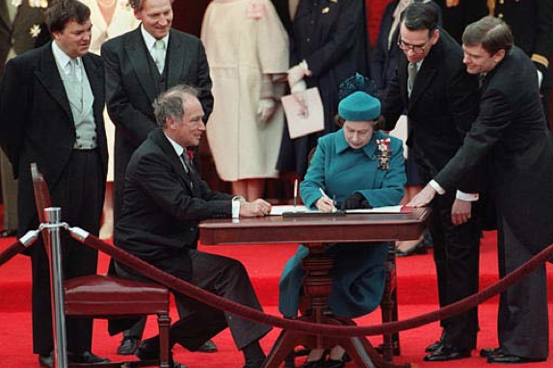
The History of the Charter
Strongly supported by PM Pierre Trudeau, but argued over by the provinces
Signed into law in 1982 by Queen Elizabeth II, along with the rest of the Canadian Constitution Act

Slide 7
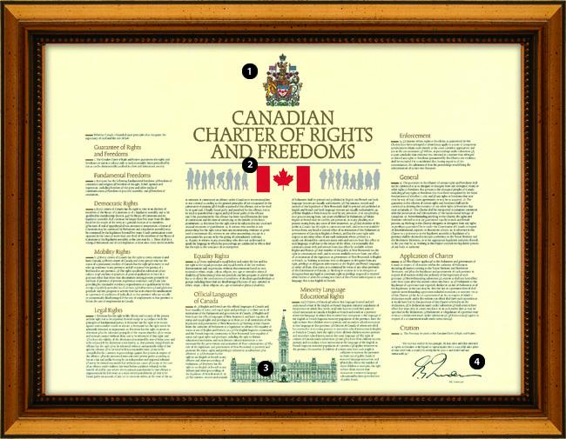
Charter of Rights and Freedoms
The Charter protects our fundamental freedoms and guarantees our rights as Canadians

Slide 8
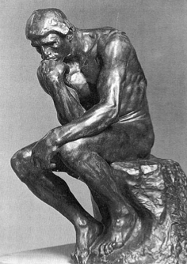
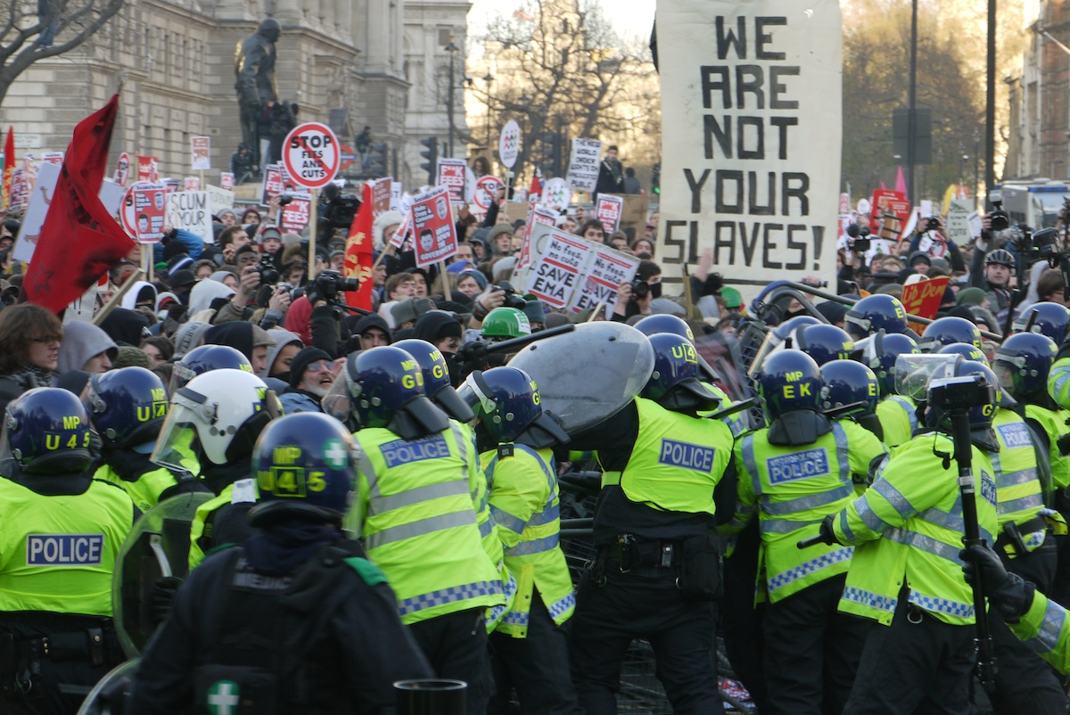
Fundamental Freedoms
Freedom of conscience and religion
Freedom of thought, belief, opinion, and expression
Freedom of peaceful assembly
Freedom to associate with whom you please

Slide 9
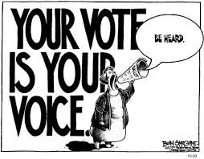
Democratic Rights
Right to express your opinion
Right to vote
Right to run for election

Slide 10
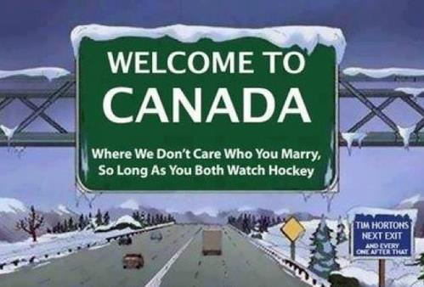
Mobility Rights
Right to enter, remain in, and leave Canada
Right to move to, live in, and work in any Canadian province or territory

Slide 11
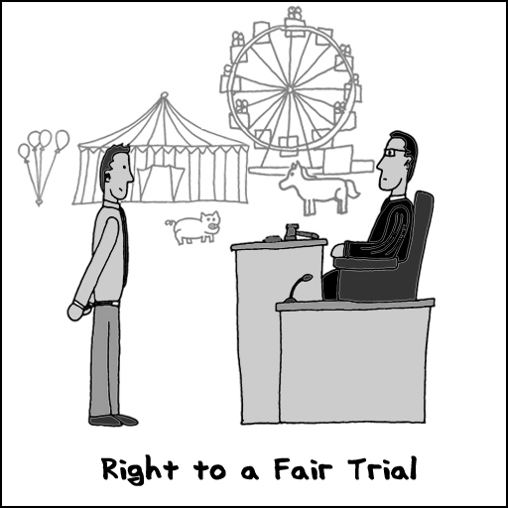
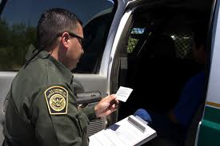
Legal Rights
Right to life, liberty, and security of the person
Right to a fair trial if you are accused of a crime

Slide 12
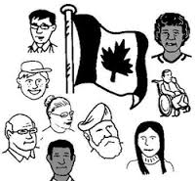
Equality Rights
Right to equality before the law regardless of race, nationality, ethnic origin, colour, religion, sex, age, or mental or physical disability

Slide 13
Language Rights
Equal status for the use of English and French in the government and courts of Canada
Right to have your children educated in either English or French where there are enough interested students

Slide 14
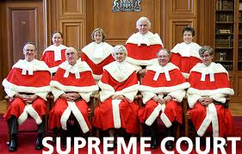
Enforcement
Right to take the matter to court if any of the rights and freedoms has been denied

