Slide 1
Influencing government

Slide 2
How can you influence government?
Individually?
- Contact MP or MLA
Write letters to civil servants (run day-to-day operations of govt)
Blog
Call radio show
In a group?
Pressure group: share interest; organized to influence govt policy
Some are institutionalized like: Assembly of First Nations
- Some are issue-oriented like a group trying to install a traffic light or stop construction at a certain West Van high school…

Slide 3
Exerting more influence
LOBBYISTS – people paid to try to influence key decision makers like bureaucrats (non-elected govt officials) in the public service (govt administrators) or politicians
Often former high-ranking members of the public service with influential connections
Big Question: What’s the danger? Is it democratic?
-insiders can persuade govt to put in place policies that are not necessarily in the public interest
-if pressure groups, which represent minority rights are too successful, is puts democracy at risk because…
…the wishes of the majority may not be heard

Slide 4
The courts
Interest groups and individuals will use the courts to influence govt and effect change
Courts must interpret laws w/i context of Constitution and Charter
Courts can only strike down laws, can’t replace them – only govt can do that

Slide 5
The role of the media
Traditional media – gives chance for politicians and political commentators to get their message out – brand recognition
Politicians also get feedback from citizens
Media can also frame an issue by focusing on what generates the most public interest
spin doctors – coach candidates on what to say (talking points) and make sure they look good
Social media – blogs, Facebook, means more people are involved in the conversation

Slide 6
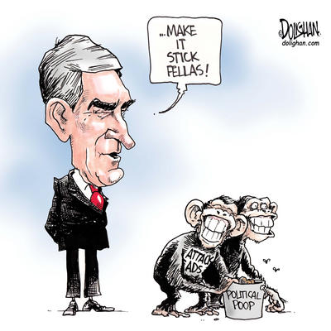
Political advertising
Liberal leader Michael Ignatieff
What is the message of the cartoonist?
How effective are attack ads?
Why might politicians use negative ads instead of positive ones?
Here’s an NDP ad on the Conservatives

Slide 7
Civil disobedience
The Big Question: What if you feel the actions of the govt are unethical or undemocratic? Is it ever acceptable to break the law as a way of protesting government action?
Civil Disobedience: intentionally breaking laws which one considers unjust.
Can you think of any great moral leaders who exercised this practice?
Mohandas Gandhi, Martin Luther King Jr, Nelson Mandela
Principles of Civil Disobedience
Should not involve violence
Should be directed against laws that are seriously harmful
Willingness to face punishment to show strength in one’s beliefs.

