Slide 1
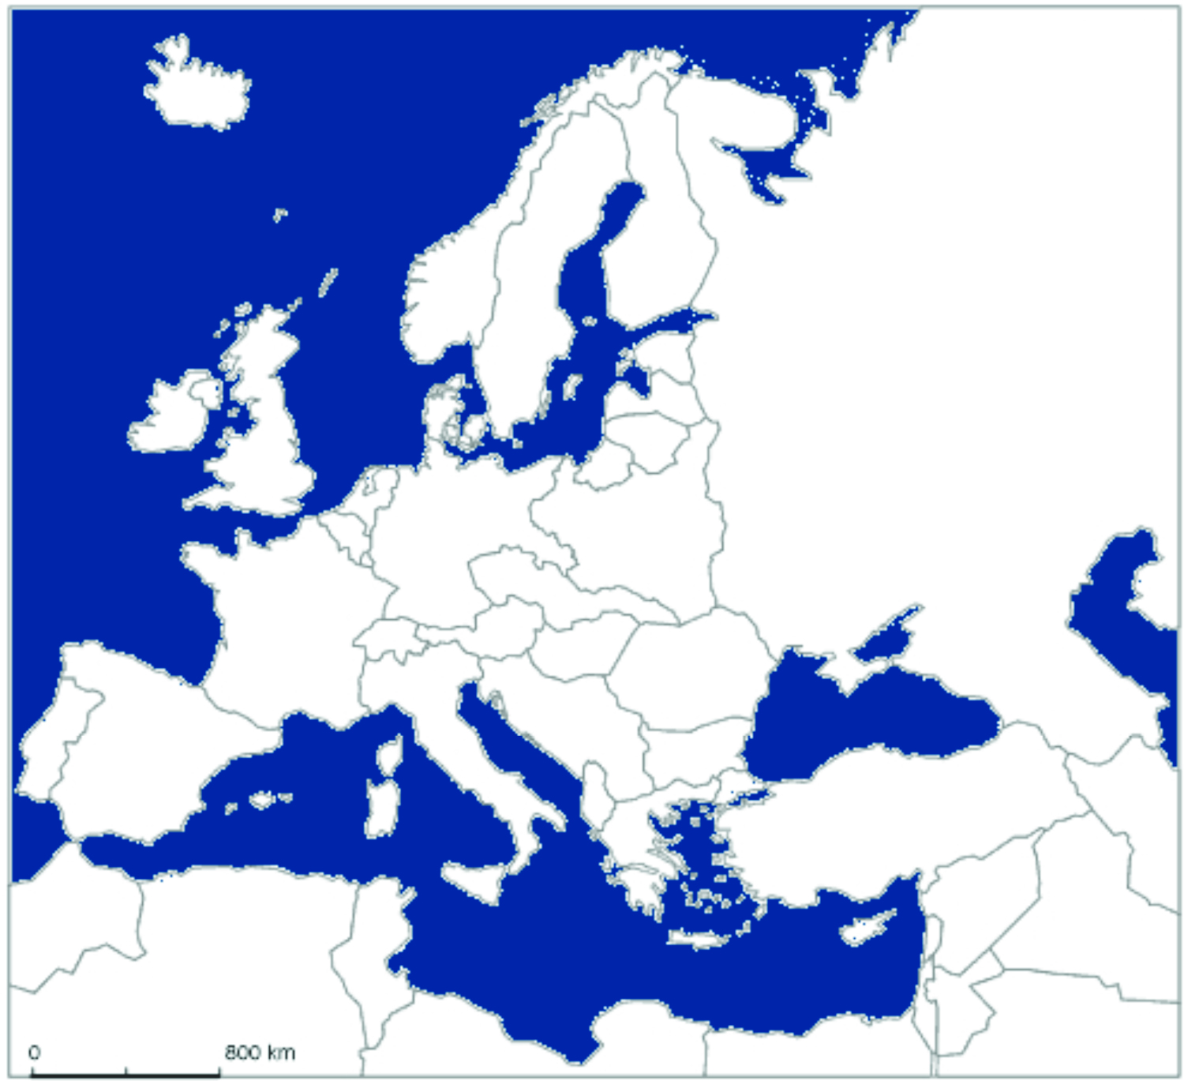
Axis Powers
Allies
Invaded by 1940
Europe in 1938 to 1940
Norway
Soviet Union
Great Britain
Denmark
Netherlands
Japan
Belgium
Germany
Poland
France
Czechoslovakia
Austria
Italy

