Slide 1
Ozone Depletion
Ch. 13 (p. 437)

Slide 2
The Ozone Layer
The ozone layer is a thin layer of gas (ozone –O3) 15-50kms above the Earth
The ozone layer protects us from excessive levels of harmful ultraviolet (UV) radiation
•Ozone depletion refers to the thinning of the ozone layer, which allows more UV radiation to reach the Earth’s surface
Thinning ozone layer discovered in the 1980s
Ozone holes at the south and north poles

Slide 3
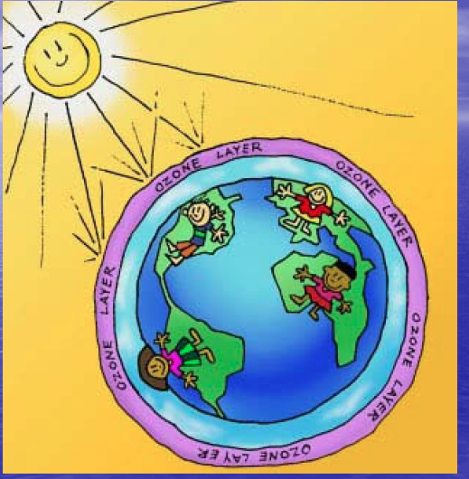

Slide 4
Ozone Depletion
Major Cause: chlorofluorocarbons (CFCs)
Chemicals invented in the 1920s
Used in refrigerator and air-conditioner coolant, foam, solvents, aerosol spray cans
CFCs are very harmful to ozone, especially at cold temperatures (north and south poles)

Slide 5
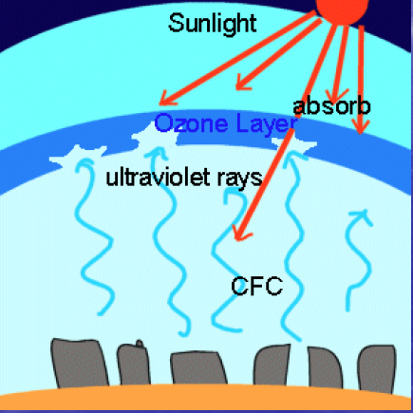

Slide 6
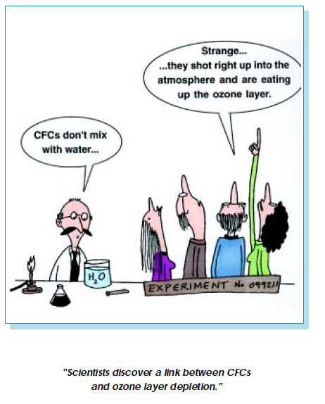

Slide 7
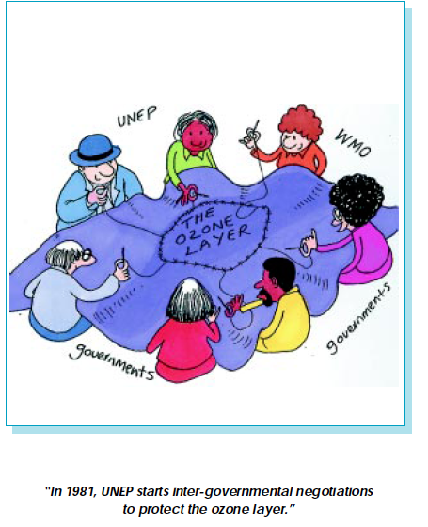
Fighting Ozone Depletion
United Nations Environmental Program (UNEP)Working on reducing the use of ozone-depleting chemicals since the 1970s

Slide 8
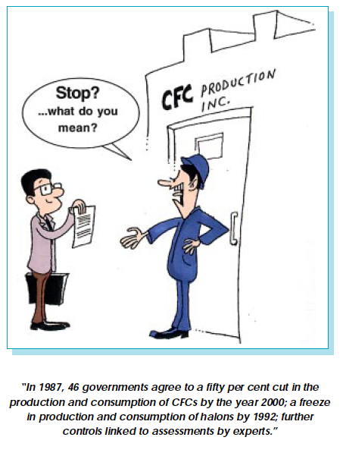
•Montreal Protocol (1987)An agreement between industrialized countries to reduce and eventually phase out the use of CFCs and other ozone-depleting chemicals

Slide 9
Fighting Ozone Depletion
CFC use has been eliminated in developed countries, but in newly industrialized and developing countries CFC use is still high
Ozone depletion is slowing
CFCs can remain in the atmosphere for decades
The ozone layer may not be back to its pre-1980 level for another 50-100 years

Slide 10
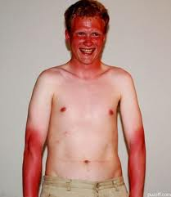
Consequences of Ozone Depletion
Effects on Human Health
High exposure to UV radiation can:
Weaken the human immune system
Cause skin and eye cancer
Cause cataracts

Slide 11
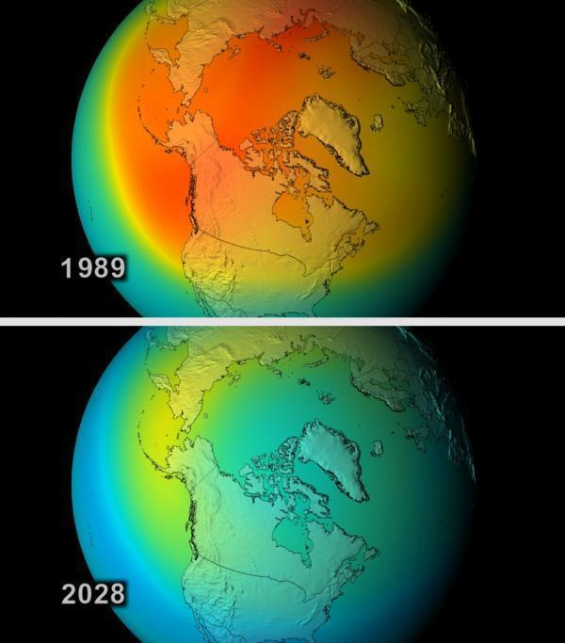
Consequences of Ozone Depletion
Effects on Plant Life
High exposure to UV radiation can:
Stunt the growth of plants
Lead to the loss of plant species
Reduce crop yields

Slide 12
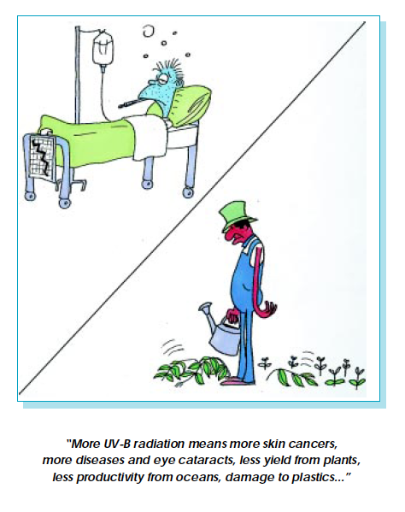

Slide 13
Consequences of Ozone Depletion
Effects on Marine Ecosystems
High exposure to UV radiation can:
Reduce phytoplankton numbers
Damage the early developmental stages of fish and other marine life
Videos:
The Coral Reefs are Dying news story from Florida
NASA: Exploring Ozone

