Slide 1
Population Challenges
Countpoint Chapter 11 (p. 373-374, 380-383)

Slide 2
Canada’s population is aging
there are more old people and fewer young people than before
this affects Canada’s dependency ratio
dependency ratio measures the proportion of a country’s population that is dependent on its workforce
“dependents” are children (0-15) and seniors (65 and older)
% of dependents out of a country’s total population is its dependency ratio
Canada: out of the total population, 18% are children and 14% are seniors, so Canada’s dependency ratio is 32% (18+14=32)
higher the dependency ratio, the more financial and social challenges a country faces
working people pay taxes, taxes fund social services (such as health care, pensions, child care, education)
Canada’s dependency ratio is increasing, so the Canadian government will need more money in the future to support the dependents
where will this money come from?
who will care for all the dependents?
Sandwich generation

Slide 3
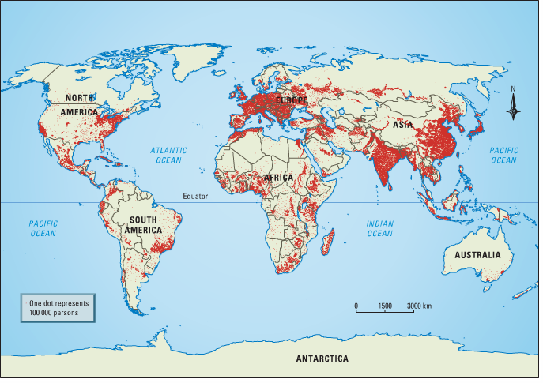
Population Distribution
…how people are spread around different regions of the world
turn to p. 380 in your textbook
some areas are heavily populated, and some are hardly populated
§ why?
Look at
p. 382

Slide 4
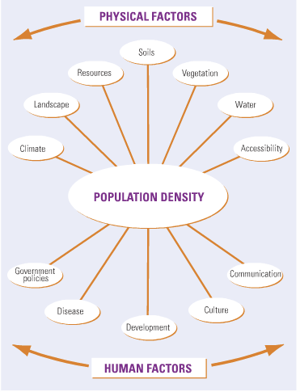

Slide 5
China’s One-Child Policy
China: 1.3 billion people (20% of the world’s population)
1980: government fears country unable to support much more population growth, enacts One-Child Policy
families with only one child rewarded
families with more than one child fined
population growth slowed, but still continues
huge effect on culture, family life
more boys than girls
should it have been done?

Slide 6
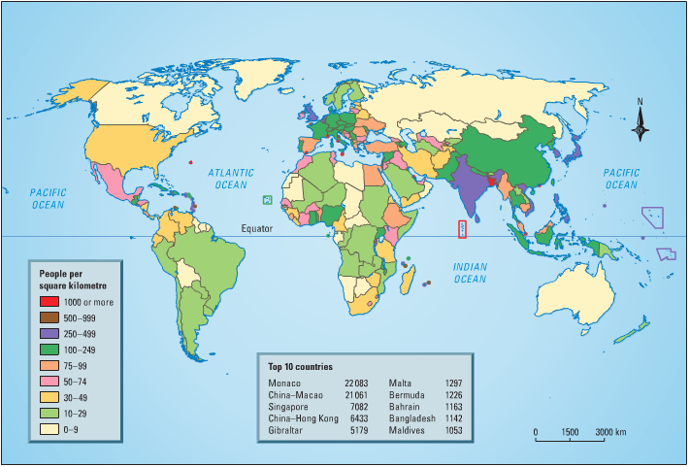
Population Density
number of people living in a certain area o usually expressed as the number of people per square kilometre
turn to p. 381

Slide 7
total population / total area in km2 = population density
Canada: 34 million / 9.98 million km2 = 3.4 people per km2 = very low density
just an average though, people aren’t spread around evenly
Bangladesh: 162 million / 144,000 km2 = 1125 people per km2 = very high density

Slide 8
Nutritional Density
how much nutrition (measured in calories) can be produced from a certain area
helps determine how many people an area can support
calories able to be produced / area in km2 = nutritional density
Canada: 62 calories per km2
China: 1192 calories per km2
Japan: 2741 calories per km2

Slide 9
Canada’s Population: The Past and the Future
Canada’s birth rate and death rate have been dropping steadily in the past 30 years =population is getting older.
In 1951, 1 in 13 Canadians was over 65 years of age. In 2020, 1 in 5 will be over that age.
Life expectancy in Canada increased from an average of 45 years in 1900 to 65 by 1950 and to 81 by the year 2010.
increasing numbers of elderly people put immense strains on social and medical services -- fewer children to look after aging parents.
age structure of Canada’s population is one of the main factors the federal government considers when deciding on the number of immigrants Canada should accept each year.
2006 Census indicates that 1.1 million of 1.6 million growth in Cdn pop since 2001 due to immigration
Immigration numbers have never come near the record level of 402 432 immigrants in 1913, which represented 5.5% of a population of 7.3 million.

