Slide 1
Poverty
Counterpoint
Ch. 12 (p. 394-399, 409-412)

Slide 2
Poverty
Definition: not being able to afford the basic necessities of life, such as food, clothing, and shelter
•Approx. 8 million people a year die from preventable poverty-related conditions, such as malnutrition/starvation or disease
•The world’s poorest 3 billion people have less money combined than the richest 50 people

Slide 3
How is Poverty Measured?
Canada
Statistics Canada classifies living in poverty as having to spend >70% of household income on food, clothing, and shelter
Low Income Cut-Off (LICO)
2007: 9.2% of Canadians live in poverty (~3 million)
World Bank
Moderate poverty = living on less than $2 a day
Almost half the world’s population
Absolute poverty = living on less than $1 a day
Over 1 billion people

Slide 4
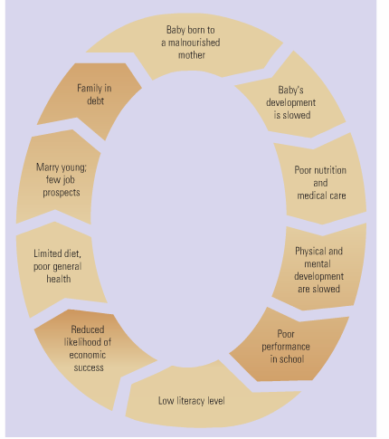
Cycle of Poverty
Poverty is a vicious cycle that is very difficult to break
Often requires help from outside

Slide 5
Causes of Poverty
Burden of Debt
After WWII, many African countries are given loans by the World Bank and International Monetary Fund to help modernize them
Some are unable to pay loans back, banks make them restructure economies, countries end up spending almost all their money to pay off debt, little left over for social services
Canada has national debt, but not enough to impoverish the country: Debt Clock
Less money to spend on services, though

Slide 6
On the Issue of Debt
Today, African countries alone owe $227 billion
Structural adjustment programs (SAP’s)- uh?
IMF wanted debtor govts to encourage foreign investment, grow cash crops for export=power countries sacrificing spending on health/education to meet demands and pay loans

Slide 7
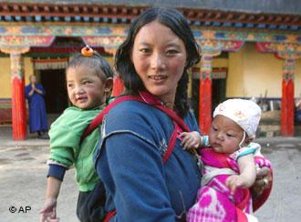
Causes of Poverty
Foreign Occupation
Example: Tibet
Region claimed by China in 1949
Tibetans oppressed and persecuted
Chinese government takes Tibet’s natural resources, Tibetan economy suffers

Slide 8
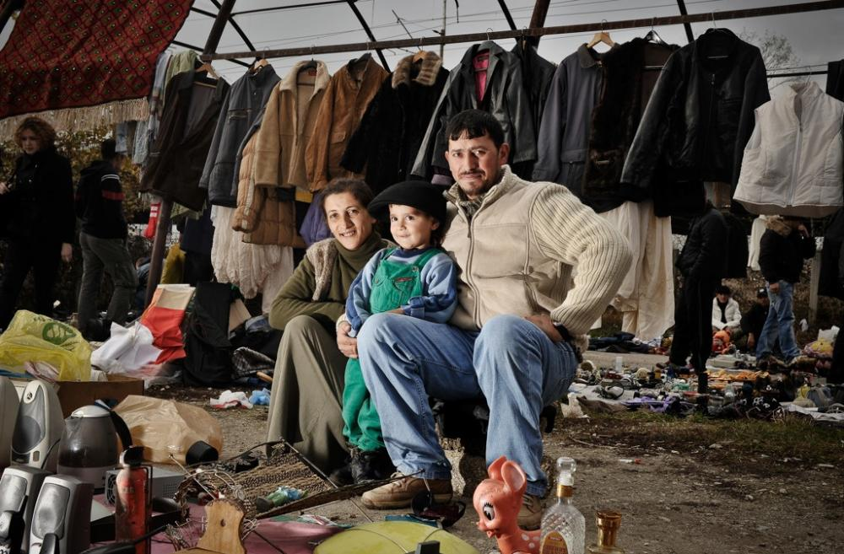
Cause of Poverty
War
Ex: Bosnia and Herzegovina
Part of Yugoslav civil war in early-1990s
War disrupts economy and trade
Leads to unemployment and poverty
Infrastructure (roads, telephone and power lines, etc) severely damaged
Country still recovering, even years after war

Slide 9
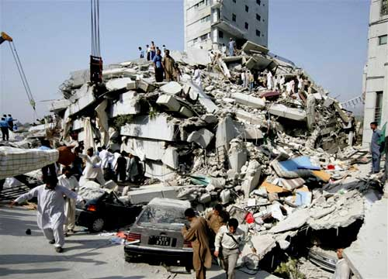
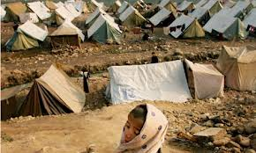
Causes of Poverty
Natural Disaster
Example: Pakistan
Oct. 2005: massive earthquake in N. Pakistan
80,000 killed, hundreds of thousands homeless
International aid difficult to get to people in need because of mountainous terrain, weather
Many live in poverty without electricity, sanitation, proper shelter until help arrives

Slide 10
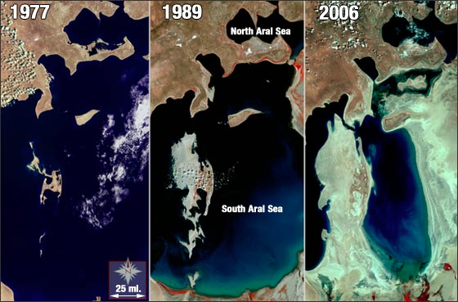
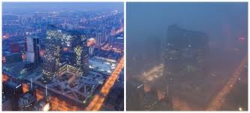
Causes of Poverty
Environmental Degradation
Example: Uzbekistan
1950s: as part of USSR, exploited by Soviet Union for its farmland
Farmland destroyed by harmful chemicals and fertilizers, over-farming
Chemicals pollute lakes and rivers
Land no longer fertile, little clean drinking water, high cancer rates

Slide 11
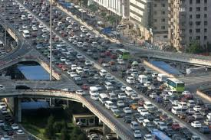
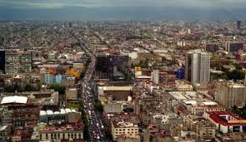
Causes of Poverty
Lack of Infrastructure
Example: Mexico City
Infrastructure = communication and transportation systems (ie. roads, power grid, sanitation and water systems, schools, hospitals, telephone lines, etc.)
Mexico City: 22 million people, poor infrastructure, sprawling shantytowns, poor unable to improve living conditions, much poverty

Slide 12
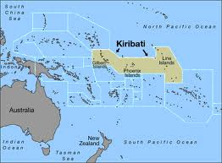
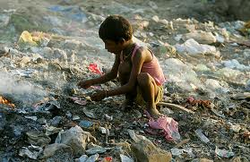
Causes of Poverty
Unemployment
Example: Kiribati
As a British colony, main export was phosphate until it ran out
Now independent, main industry gone, much unemployment (70% unemployment rate)
People unable to earn money, live in poverty

Slide 13
THE VULNERABLE ONES: WOMEN AND CHILDREN
The Position of Women
Many developing countries have male-dominated societies where females and children have lower status than men.
May have no legal rights or may be treated as property.
Women may be killed to satisfy a family’s honour.
In some tribal societies, women and children may eat whatever is left after the men have finished, which can lead to malnutrition.

Slide 14
Women
woman in a developing country
works for over 12hr/day to ensure survival of her family
the rate of literacy is lower among women than among men.
Only 1/3 of girls in rural India go to school compared to more than ½ of boys. When a woman is married she is reborn into her husband’s family (incentive for her to marry young)
Demographers agree that economic development and the fertility rate of countries are connected.
Study after study shows that better educated women have fewer children.
They tend to marry later and have children later.
Educated women know more about the importance of immunization, clean water, and good nutrition.

Slide 15
Children in Crisis
Children in some developing nations have few educational opportunities and are often exploited as child labour or trapped in the sex trade.
Africa is the continent where children face the greatest risks

Slide 16
Under-Five Mortality Rate
(U5MR) – principal measure of human development used by UNICEF.
2008 UNICEF report—average 26 000 children under 5 die every day
More than ½ of the under-5 deaths in developing countries are due to malnutrition.
3 million children die each year of diseases such as gastroenteritis that are related to poor sanitation and lack of hygiene and clean water.

Slide 17
Children at War
Approximately 540 million children in the world live in dangerous and unstable situations.
Civil wars, land mines, ethnic cleansing, and other dangers affect children and their mothers.
at least 300 000 children and young adults under the age of 18 who were actively engaged in 36 armed conflicts around the world, many of them in Africa
In wars in Sudan and Somalia, 11- and 12-year-olds have been involved in battle.

Slide 18
Working Children
Abandoned children in cities live by their wits, begging, stealing, or selling sex.
There are no labour laws that regulate safety conditions or the hours that children work.
70% of child labour in agriculture
Bonded labour-work to payoff family debt

Slide 19
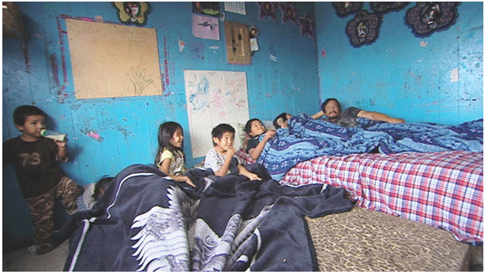
Poverty on Aboriginal Reserves
1996 report of the Royal Commission on Aboriginal Peoples
Poor sanitation and water quality, substandard housing and health care are linked to high levels of infant mortality, infectious diseases, and safety concerns.
Warns of a rapidly growing population straining the resources of Aboriginal communities.
Points out that reserves are too small even to support existing numbers.
Most Aboriginal peoples in Canada have neither effective control over their existing lands nor sufficient access to lands and resources outside their reserves and communities.
CBC looks at the Housing Issues on Reserves

Slide 20
The Health Crisis
Many poverty stricken countries also have severe health problems
•Clean Water
Lack of clean drinking water leads to disease
1.2 billion people lack access to clean water
2 billion people lack proper sanitation
Over 5 million people die every year from diseases spread by dirty water
Children are especially vulnerable

Slide 21
The Health Crisis
HIV/AIDS
Because of burden of debt in Africa, many nations have little money to spend on health care
Doctors go to more prosperous countries
Canada: 1 doctor for every 400 people
Zimbabwe: 1 doctor for every 17,000 people
Sub-Saharan Africa: 7% of adults have HIV/AIDS
Swaziland: 26% of adults
Over 4 million orphans because of AIDS

Slide 22
The Health Crisis
Because there’s no cure for AIDS yet, prevention is the key
Much misinformation and ignorance about AIDS prevention, including some politicians
Medication to prolong life/prevent spread is expensive, very few poor able acquire itIn 2004, only 12% of those infected living in a developing country received medication

