Slide 1
Reaction & Recovery: The Great Depression Part II
Ch 4 Counterpoints

Slide 2
The American Reaction

Slide 3
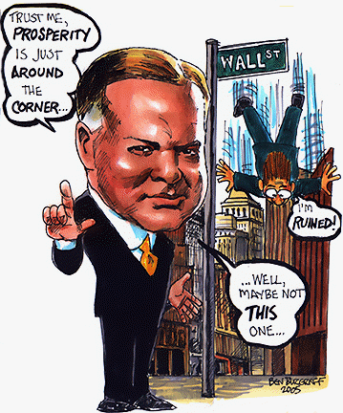
I. President Hoover (in office from 1929-1933)…
Did not believe in interfering with the ‘free hand’ of the market
Felt that states & cities should be responsible for providing unemployment relief programs
He said he would…
  cut taxes
  expand public works spending
But he…
  Increased taxes
  Did not intro any relief programs
  Increased tariffs instead
Hence the development of the “Hooverville’, communities with slum like conditions

Slide 4
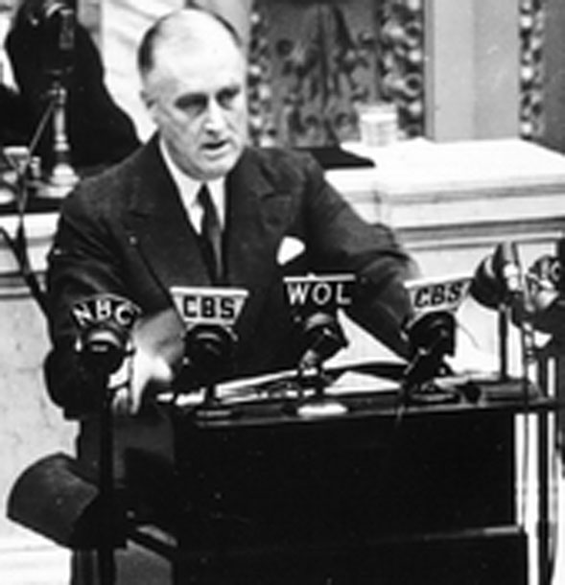
II. Under President F.D. Roosevelt (1933-1945)
Followed the theory of “Keynesian Economics”
  The belief that gov’ts should put $ into the economy in order to get it out of the depression.
  This is called deficit financing (borrowing $ to put back into useful projects/improvements)
Implemented the NEW DEAL (A set of relief programs such as…
  Emergency Relief Administration, (granted funds to the states for unemployment relief)
  Works Progress Administration and the Civilian Conservation Corps (hired unemployed to work on local projects)
  Established the Tennessee Valley Authority, (built dams, power stations and improved agriculture)

Slide 5
The Canadian Reaction

Slide 6
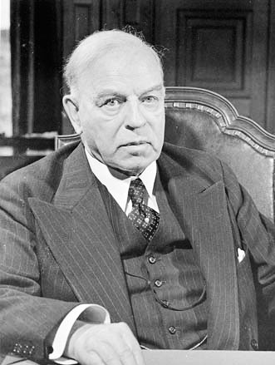
III. The Situation under W. L. Mackenzie King (1926-1930)…
‘Riding the Rails’
  riding freight trains in search of work, but not finding any, then doing it as something to do
‘Pogey’ or Dole
  welfare that was lower than the lowest paying jobs to discourage ppl from being on it

Slide 7
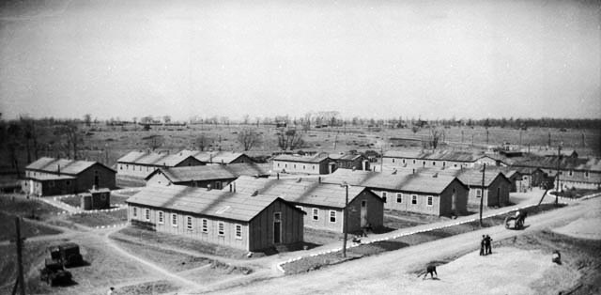
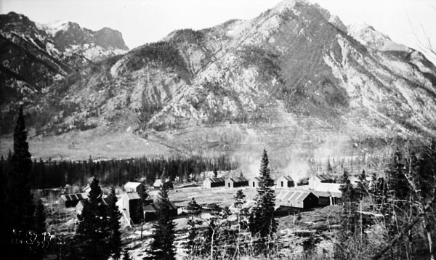
IV. Under Prime Minister R. B. Bennet (1930-1935)
  Unemployment Relief Camps’
    work camps open to single unemployed me
  established high ‘tariffs’
    high tax on goods brought into Canada
    this made Cnd staple goods cheaper

Slide 8
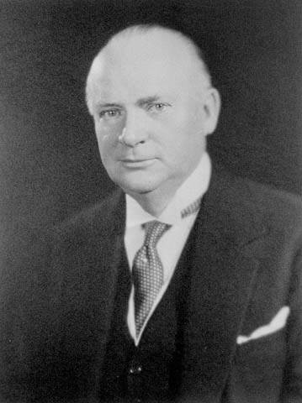
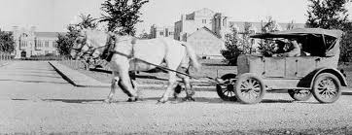
V. Bennett’s New Deal
Like FDR’s plan
Bennett’s plan called for: maximum work week, minimum wage, regulations on working conditions, unemployment insurance, health and accident insurance, revised old age pension plan and agricultural support programs.
He was criticized for being ineffective
(the Bennett Buggy)

Slide 9
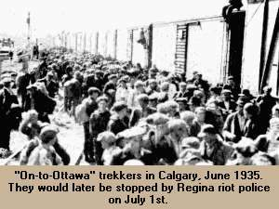
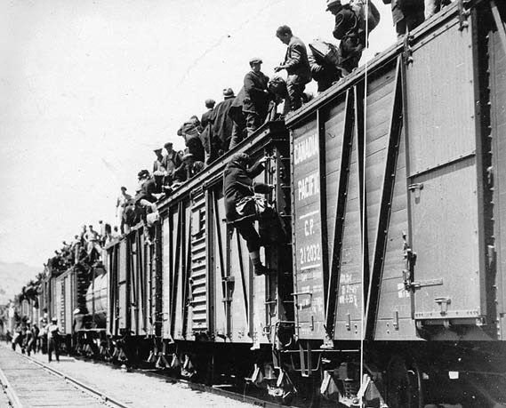
VI. On-to-Ottawa Trek
Background: Relief camp workers very frustrated with social & economic conditions
  Wages low ( $0.20/day)
  Room & board conditions deemed terrible
  and really very little work available,
  didn’t feel the ‘pride’ associated with a real job
The Trek:
  In June 1935, workers boarded train heading to Ottawa to protest to gov’t
  Were stopped in Regina by the RCMP
  The trek became a riot…

Slide 10
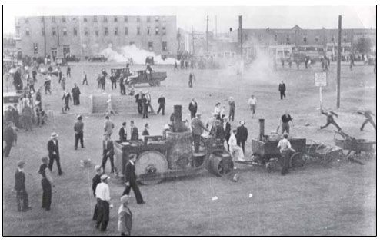
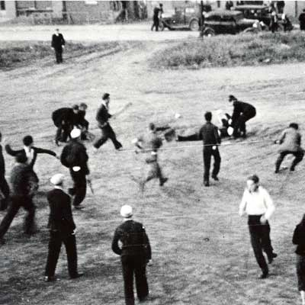
VII. Regina Riot 1935
RCMP fought crowd for 3 hrs, many trekkers injured, 1 officer beaten
Results:
  Bennett losing favor with the people,
  1935 Bennett loses election and W. L. Mackenzie King is back in gov’t

Slide 11
Consequences of the Depression

Slide 12
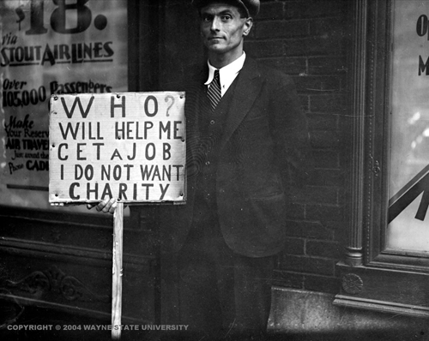
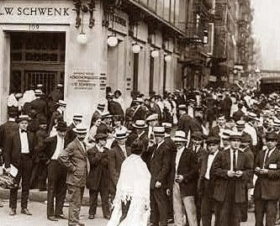
Unemployment
  In Cnda (appox. 25%), US (approx 30%)
  No job means no buying/demand for goods
Banking Failures
  Businesses c/n pay off their loans when banks called them back in
  Result: businesses & banks went bankrupt
  This happened mostly in USA

Slide 13
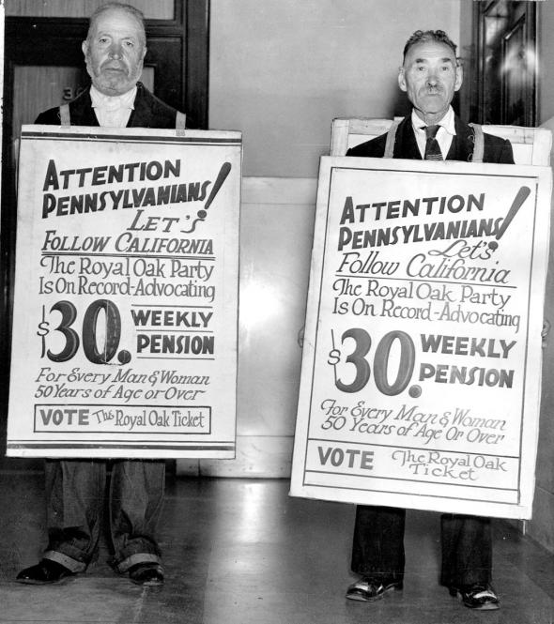
III. Political Consequences
Totalitarian Leaders Emerge in Unstable Political and Economic Times
  Germany—HITLER
  Russia –STALIN
  Italy –MUSSOLINI
Change in the Role of Gov’t
  Gov’t takes active role in caring for its citizens, now provides a ‘social safety net’
    Unemployment insurance
    Sick benefits
    Child benefits (ie. family allowance)
    Welfare system in place
  Laissez-faire was over
  Gov’t managed economy by way of
    Tax policy –adjusting taxes
    Monetary policy –adjusting interest rates\
    Fiscal policy – adjusting gov’t spending

Slide 14
The Politics of Protest in 1930’s Canada

Slide 15
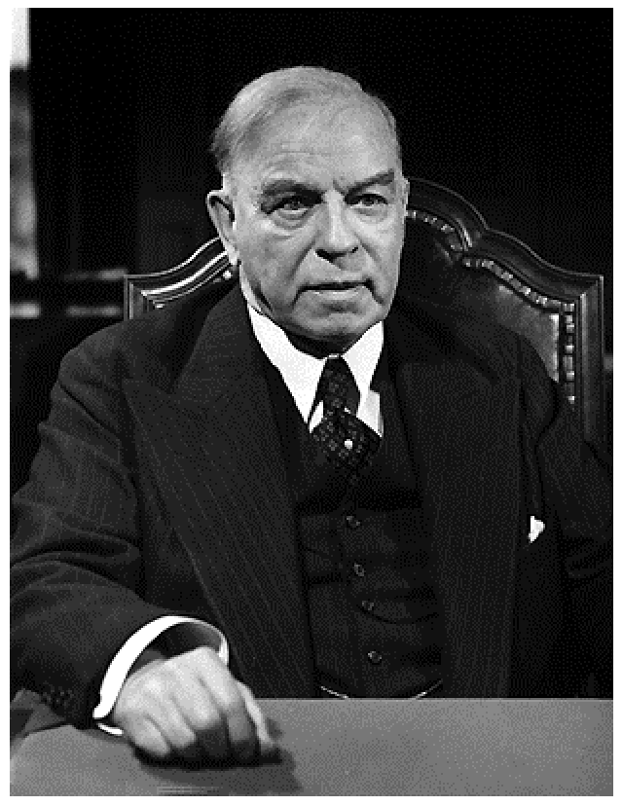
“King or Chaos”
This slogan helped bring King and the Liberals back to power in 1935.
Bennett’s “New Deal” collapsed with the fall of his government.
Two new political parties, the CCF and Social Credit, elected MPs for the first time.
These “parties of protest” were a response to the failures of the Liberals and Conservatives.
Mackenzie King

Slide 16
The Cooperative Commonwealth Federation
The CCF was founded in Saskatchewan in 1933.
Its program was outlined in the Regina Manifesto.
The basic beliefs were that the government should own all important industries.
Business and the wealthy should be taxed to provide social benefits for the citizens.
Tax the Wealthy

Slide 17
Social Credit
This political movement was founded in Alberta and its first leader was William Aberhart or “Bible Bill.”
He followed the theories of a Major Douglas who believed that there should be more money in circulation to stimulate the economy.
Social Credit promised a “Basic Dividend” of $25 to each citizen over the age of twenty-one.
This never happened but Social Credit became the party of business and free enterprise.
$ 25

Slide 18
Union Nationale
Formed by Maurice Duplessis and some disillusioned Liberals
Supported Quebec Nationalism
Relied heavily on support from Catholic Church and rural voters
Blamed Quebec’s problems on English minority
Wanted to improve working conditions, social insurance programs, publicly owned power companies and farm credits

Slide 19
The Liberals after 1935
King and the Liberals returned to power just as the economy began to slowly improve.
The Purvis Commission convinced King that the federal government had to take some financial responsibility for unemployment.
The Rowell-Sirois Commission was appointed to investigate regional economic disparity.

Slide 20
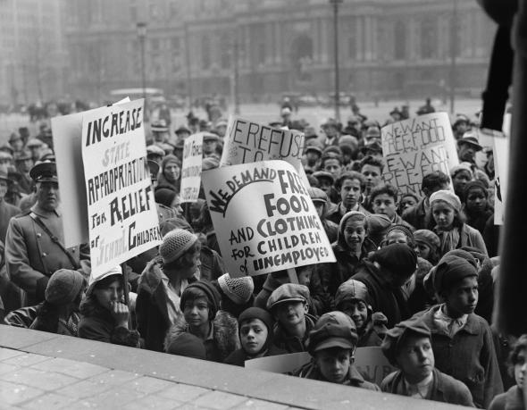
Assignment
Direct or Indirect Consequences of the Great Depression activity

