Slide 1
Responding to Global Warming
Ch. 13 (p. 444-449)

Slide 2
How Do You Slow Global Warming?
According to the majority of climatologists, global warming is caused by the Greenhouse Effect
•The Greenhouse Effect is caused by too much greenhouse gas
•Therefore, reducing greenhouse gas emissions will help to slow global warming
Especially carbon dioxide (CO2)
Individually, you can reduce your “carbon footprint”
Carbon footprint = how much greenhouse gas your lifestyle is responsible for producing in a year
Measured in tonnes of carbon dioxide

Slide 3
The Kyoto Protocol
An international agreement negotiated in 1997
In Kyoto, Japan
Sometimes called the “Kyoto Accord”
By signing the Kyoto Protocol, countries promised to reduce their greenhouse gas emissions to 6% less than their 1990 levels by 2012
Is a legally binding agreement
175 countries signed (or “ratified”) it
Notable Exception: USA

Slide 4
Canada and the Kyoto Protocol
Canada signed it in 2002
Liberal Party in power
70% public support for Kyoto Protocol
Some businesses and Conservative Party against it
Felt that cutting emissions would be too expensive, slow economic growth
Would make Canadian businesses unable to compete with American businesses (US not part of Kyoto)
Alberta oil and gas industry most vocal in opposition
Liberal government unable to come up with workable plan to cut emissions
One Tonne Challenge
GHG emissions increased to 22% above 1990 levels by 2006

Slide 5
Canada and the Kyoto Protocol
2006: Conservative Party elected
Announces that Canada unable to meet Kyoto requirements, will no longer be governed by its goals
Government sets own emission goals and requirements
Reduce GHG emissions to 20% less than 2006 levels by 2020
Greenhouse gas emissions are now 27% above 1990 levels

Slide 6
BC and Greenhouse Gas Emissions
2008: BC institutes a carbon tax
Tax put on fossil fuels to discourage use
Includes a 3.6¢ per litre tax on gasoline
Goals: cut GHG emissions to 33% below 2007 levels by 2020, and 80% by 2050
Government is “carbon-neutral”
GHG emissions produced by the BC government that can not be reduced are “offset” by buying “carbon-offsets”
Carbon-offsets are usually investments in companies or organizations that are working to reduce GHG emissions (planting trees, developing sources of renewable energy, etc.)

Slide 7
Copenhagen Climate Change Conference
Held in Copenhagen, Denmark -Dec 2009
•Was a UN conference held to come up with a plan to combat climate change after 2012 (Kyoto)
•Resulted in the Copenhagen AccordSays that global warming should be kept below 2C
Kyoto Protocol should continue to be followed
Developed countries to create a fund to help developing countries reduce GHG emissions
Does not include emission goals
Is not legally binding
Considered a “good start” or a “failure”, depending on whom you ask

Slide 8
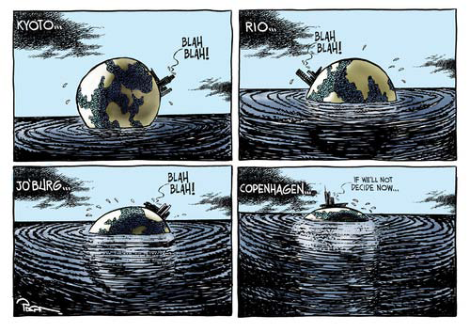

Slide 9
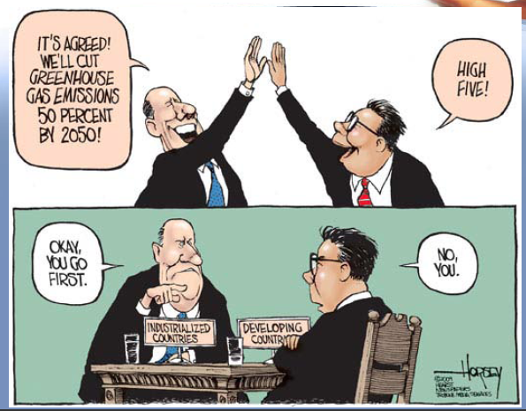

Slide 10
Where does the world stand on Kyoto Targets?
CBC report Kyoto Protocol Dec 31, 2012

Slide 11
