Slide 1
Standard of Living
Chapter 12

Slide 2
Standard of Living
Definition: a measure of the prosperity and quality of life of a country
In general, the higher the standard of living of a country, the better the life of its citizens.
Standards of living can vary greatly from country to country

Slide 3
Measuring Standards of Living
Human Development Index
published every year by the United Nations
ranks countries by standard of living
uses three criteria to determine rankings
Education, Health, and Economics

Slide 4
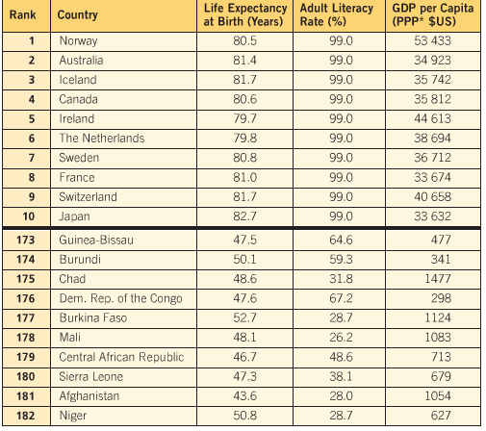
Top Ten/Bottom Ten 2009

Slide 5
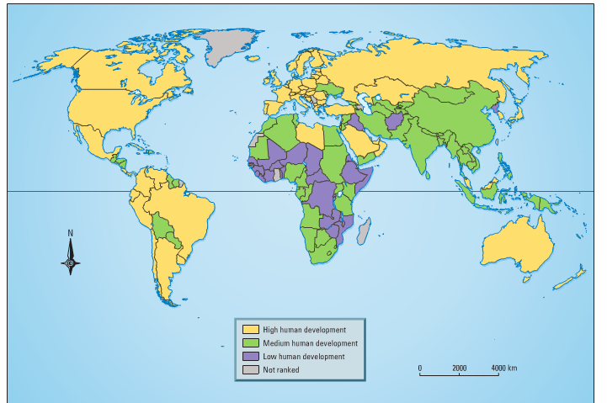
Human Development Index 2009

Slide 6
Human Development Index
Education
Literacy rates
Mean Years of Schooling: average number of years spent going to school
Expected Years of Schooling: number of years people are expected to go to school for
Education increases the spread of useful information and leads to better job opportunities

Slide 7
Human Development Index
Health
Life expectancy: number of years a baby born that year is expected to live
People in countries with well-developed medical systems and lots of food/clean water live longer and have better lives.

Slide 8
Human Development Index
Economics
Gross National Income (GNI) per capita
The average income of a person in a year
per capita = per person
Averaged across population (GNI / total population)
More accurate than Gross Domestic Product (GDP)GDP: the total value of all goods and services produced in a country in one year
The more money a person makes, the better its economy, the better the lives of the population.

Slide 9
Human Development Index
Criticisms
Not all countries keep track of these stats, some lie
Doesn’t take into account the environment, crime, politics, freedoms/rights, etc.
Doesn’t take into account enough statistics
Much economic activity in poor countries is not reported (ie. trading/bartering, “under the table” cash dealings)
Relies too much on averages
Ex. A country with a small number of super-rich people and many poor people can have a high per capita GNI, and therefore a high ranking (ie. Saudi Arabia).

Slide 10
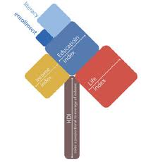
Human Development Index world map
2013 HUMAN DEVELOMENT REPORT

Slide 11
Human Development Index - Canada
Traditionally ranks very high in the UN Human Development Index
#1 for most of the 1990s
#4 in 2009, but #8 in 2010 using new measurements
Human Poverty Index -#12
Takes into account a country’s level of poverty
Gender-Related Development Index -#4
Takes into account gender differences in health/education/economy
Gender Empowerment Measure -#12
Measures gender differences in economic and political participation

Slide 12
Classifying Countries
Countries with similar standards of living are often grouped together into certain categories:
Developed Countries: industrialized economy, good education and health care systems, little to no population growth (ex. Canada and USA)
Newly Industrialized Countries: recently shifted from an agricultural to industrialized economy, increasing population (ex. China and India)

Slide 13
Classifying Countries
Developing Countries: lower standards of living, more agriculturally based economy, inequalities in education/health care, high population growth (ex. Vietnam and Chile)
•Highly Indebted Poor Countries: less developed countries that are greatly in debt with high levels of poverty (ex. Ethiopia and Bolivia)

