Slide 1
The Start of World War I

Slide 2
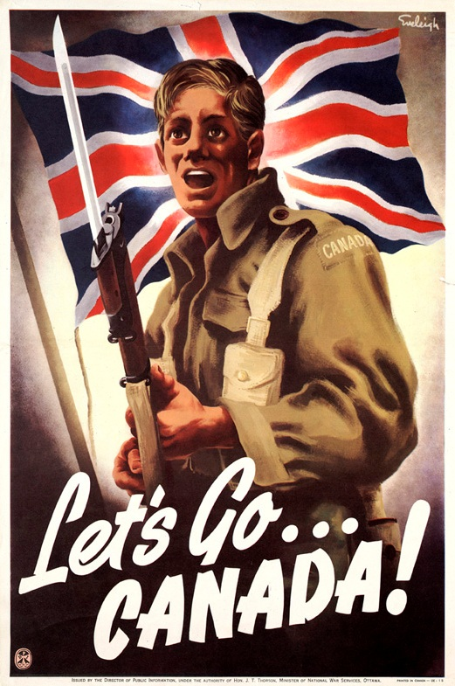
Canada’s Response
Aug 4, 1914: Britain declared war on Germany and Canada was automatically at war.
(Britain still controlled Canada’s foreign policy)

Slide 3
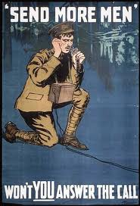
War Measures Act
• PM Borden’s Gov’t drafted a War Measures Act, giving the gov’t strong powers to act, suspending individual rights and usual procedures.
^{War Measures Act}
– A law meant to ensure “security, defence, peace, order, and welfare of Canada”
– Gave government immense control over country
• Business, transportation, manufacturing, trade, production, etc.

Slide 4
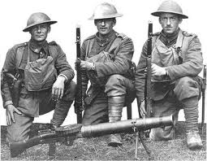
War Measures Act continued
Limit civil liberties (ex. habeas corpus suspended)
“Enemy aliens”: recent immigrants from Germany and Austria-Hungary could be deported or imprisoned
Carry special ID cards and report regularly to registration officers – Over 8000 held in internment camps
^{Mail censored}
Publications in “enemy” languages banned

Slide 5
Canada’s Response
Liberals pledged a political truce
Many hoped this would unite the English and French.
By Sept there were 32,000 volunteers, (it sounded like a grand adventure!)
Everyone expected the war to be over by Christmas.

Slide 6
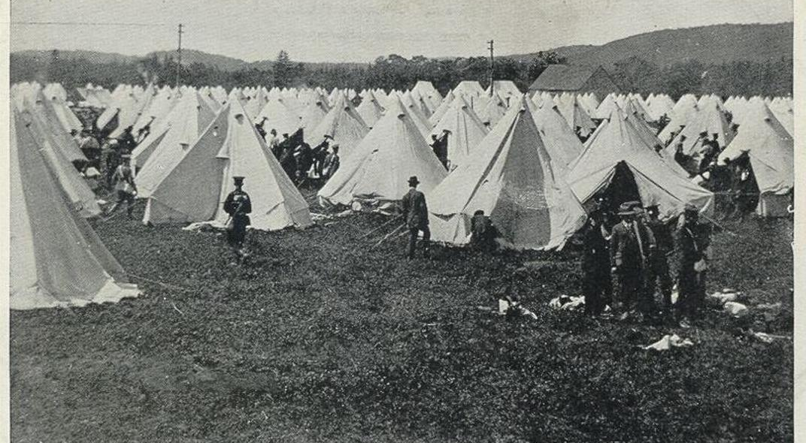
Over 30,000 volunteers converged on Valcartier, Que., for training in the first few weeks of the war.

Slide 7
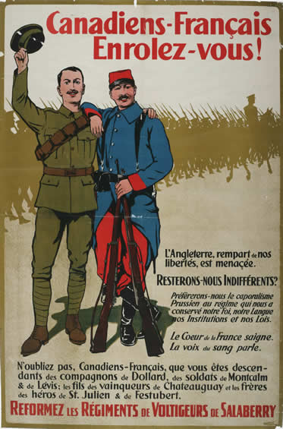
Canada’s Response
Soon, enthusiasm faded. It would obviously last past Christmas.
French Canadians were opposed to fighting a war for the British.
Since they felt no particular allegiance to France, they were not interested in fighting.

Slide 8
Opening Move
The Germans faced a 2 front war with France & Russia.
What to do?

Slide 9
Solution: The Schlieffen Plan
Weaker German units would hold along the French Border.
Stronger units would attack Belgium, moving quickly to N. France, encircling Paris.
With France defeated, Germany could turn and attack Russia.

Slide 10
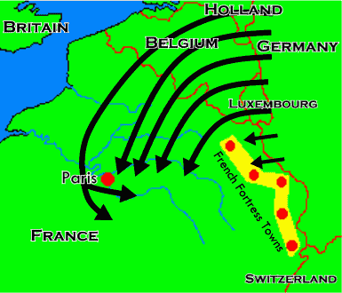
Schlieffen Plan

Slide 11
PROBLEMS with the Schlieffen Plan
- The plan assumed Belgium would not fight.
WRONG- they did, slowing German progress.
plan assumed Britain would not honour an old treaty guaranteeing Belgium’s neutrality.
WRONG- they did. France was going to get help..
The plan assumed that it would take old Russia a long time to mobilize.
WRONG- it took only 10 days, meaning German troops had to be moved immediately to the Eastern front.

Slide 12
Because of these problems, the German offensive stalled
Faced with a retreat, the Generals insisted that the soldiers dig in defensive trenches so they could hold the parts of France and Belgium they already had taken.

