Slide 1
WWI: Technologies, Techniques and Realities
Life on the Battlefront
The Nature of Warfare

Slide 2
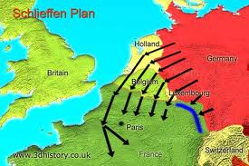
The War on Land
Schlieffen Plan (two front war)
▪ Germany’s plan to quickly invade France, via
Belgium, and capture Paris
Then turn attention to Russia
Two critical assumptions:
1. It would take Russia time to mobilize (but Russian forces were already on move)
2. Britain would remain neutral (did in past, but made new promise to defend France)

Slide 3
Schleiffen Plan continued
The reality:
By August 1914, Germans 50km from Paris, but pushed into N. France by French and British
German leaders weaken the plan:
1. pull troops from west to reinforce eastern defence
2. soldiers exhausted by attack through Belgium (didn’t expect they would fight back)
▪ Stalemate – both sides dig defensive trenches ►Eventually stretch from English Channel to Switzerland

Slide 4
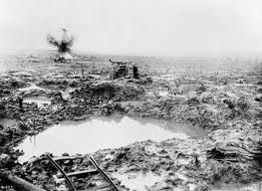
War on Land
Trench Warfare
▪ Before WWI, cavalry would charge each other on open fields with rifles and bayonets
▪ In WWI, new weapons (i.e. machine guns, artillery, landmines) made open charges suicidal
▪ Commanders stuck in old-fashioned mindset
►Led soldiers to slaughter
►War of attrition – repeatedly attack until one side unable to continue (exhaustion, not enough soldiers)

Slide 5
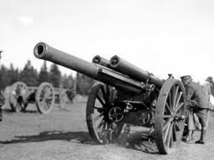
The War on Land
^{Technology}
^{-machine guns and artillery}
►Batteries fired shells filled with explosives and shrapnel
^{-Tanks}
►Developed by 1916 to crush barbed wire and protect
soldiers while crossing no man’s land
►Often stuck in mud, but improved
^{-Poison Gas}
►First used by Germans at Ypres in 1915
►Chlorine, phosgene, or mustard gas
^{-Submarines}
►used to destroy merchant ships supplying Brit

Slide 6
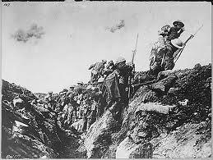
Life in the Trenches
►Cold and damp,
often flooded and muddy
▪ Trench foot
►Overrun by rats and lice
►Injuries often get infected
▪ If injured in no man’s land, usually left to die, too dangerous to be taken back
►Constant threat of snipers and artillery shells
“Going over the top” meant crossing no man’s land to capture enemy’s front line
Lucky to survive

Slide 7
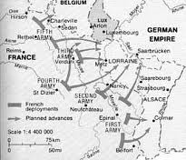
Plan 17
Adopted by French General
Staff in 1913
Implemented as an offensive into Alsace-Lorraine
German defence was far stronger than predicted
In retrospect, the German Schlieffen Plan had intended to lure France in
Within a few weeks, the French were back in their starting positions, having suffered great losses.

Slide 8
War in the Air and Sea

Slide 9
The War in the Air
►At beginning, mostly aerial reconnaissance
►Soon, fighter aircraft with machine guns
▪ “dogfights”: air battles between planes
▪ Fighter pilots: glamourous, better living conditions
▪ 1917, average life expectancy of a fighter pilot was three weeks (no parachutes)
▪ No Canadian air force; joined Royal Flying Corps (RFC), part of Royal Air Force (RAF)
▪ Several Canadian “aces” – Billy Bishop; Roy Brown (shot down Red Baron)

Slide 10
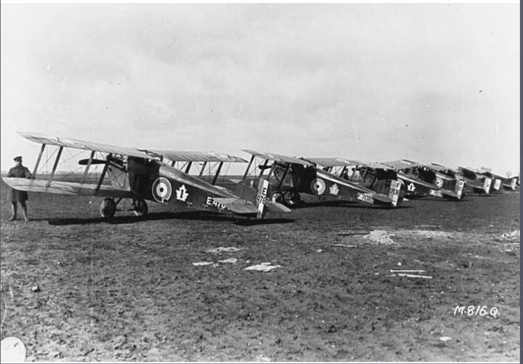

Slide 11
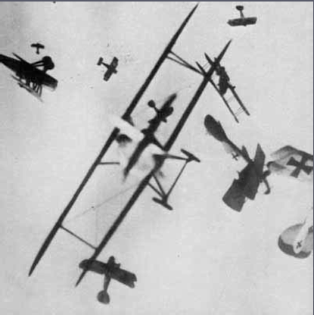
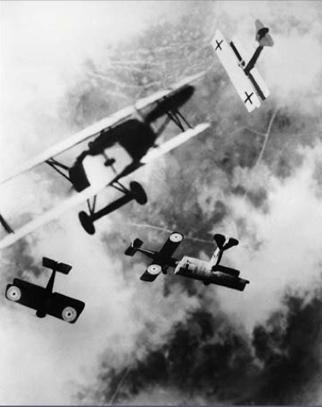

Slide 12
The War in the Air
►Technology
▪ German dirigibles (aka blimps, Zeppelins)
►Reconnaissance and bombing missions
►Britain used small ones to protect ships from submarines
▪ Fighter Planes

Slide 13
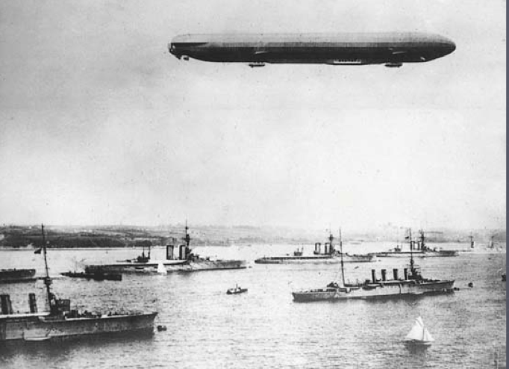

Slide 14
The War at Sea
▪Britain and Germany had the strongest navies
►German U-boats (aka submarines), armed with torpedoes, hunted British warships and merchant ships
▪Britain had no defense at first, then developed convoy system (travelling in groups) and sonar
►Canada’s merchant marine – transported supplies to Britain, departing from Halifax

Slide 15
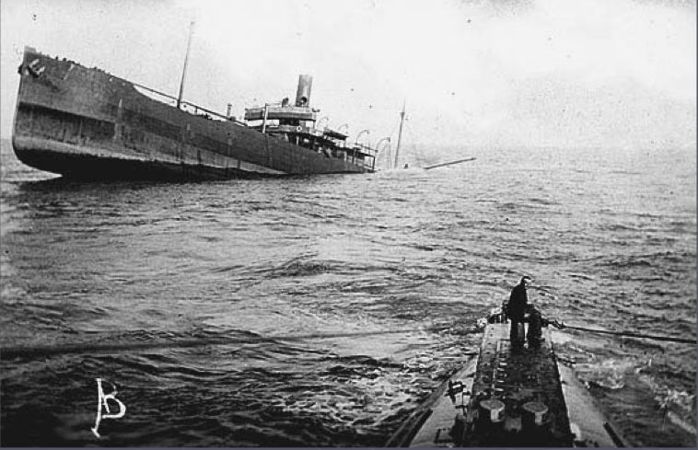

Slide 16
The War at Sea
►The Sinking of the Lusitania
▪ In 1915, German U-boat sank British passenger liner Lusitania off the coast of Ireland
►1200 passengers died, many Canadians and Americans
►Germany felt justified because of ammunition onboard
►United States outraged; Germans agree to stop targeting “neutral” ships
►In 1917, Germans had resumed targeting American ships
►United States declares war on Germany April 6, 1917

Slide 17
