Slide 1
Water: Our Most Valuable Resource
Ch. 13 (p. 432-436)

Slide 2
The Indispensable Resource
We require at least 5 litres of fresh water each day to remain in good health
Also, much fresh water is needed for agriculture and industry
Only 3% of the world’s water is fresh water
Most fresh water is frozen in ice caps and glaciers, the rest is in liquid form underground (groundwater) and on the surface (lakes and rivers)
Canada has a large amount of fresh water
20% of the world’s fresh water

Slide 3
Underground Water
Fresh water underground is called groundwater and is stored in aquifers, areas deep beneath the Earth’s surface that can be accessed by wells
Much groundwater is used for agriculture to irrigate farmland
70% of all fresh water use
Herbicides and other chemicals can seep into and pollute groundwater
Groundwater is more cheap to access than surface water and does not need to be stored in reservoirs

Slide 4
Underground Water
Unfortunately, aquifers are slow to refill, unlike rivers and lakes
Groundwater in aquifers comes from surface water slowly seeping into the Earth through permeable (ie. porous) rock
Water Table
The top level of groundwater (ie. closest to the surface) –see p. 433 (next slide)
Overpumping of groundwater leads to falling water tables and makes the water harder to get
Major farming nations, such as the US, China, and India, are experiencing this problem

Slide 5
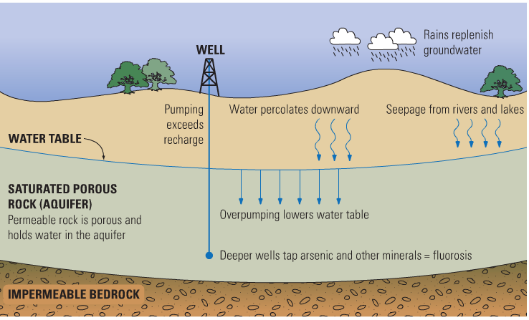

Slide 6
Surface Water
Surface water (lakes, rivers, coastal waters) is very vulnerable to pollution
Municipal pollution (sewage, household chemicals) and agricultural chemicals
Industrial pollution has the largest impact on the quality of Canada’s fresh water
Industrial waste often dumped into rivers and oceans
Industrial emissions are the main cause of acid precipitation in Canada
Acid precipitation damages vegetation and the soil, and also decreases the quality of fresh water

Slide 7
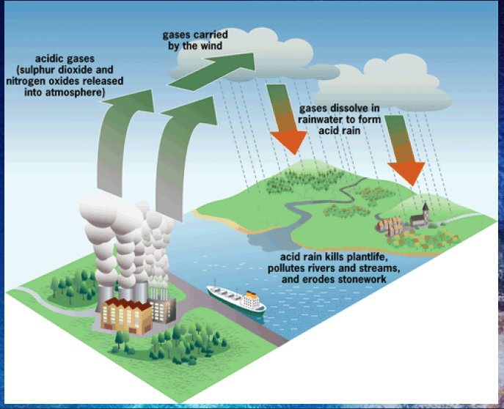

Slide 8
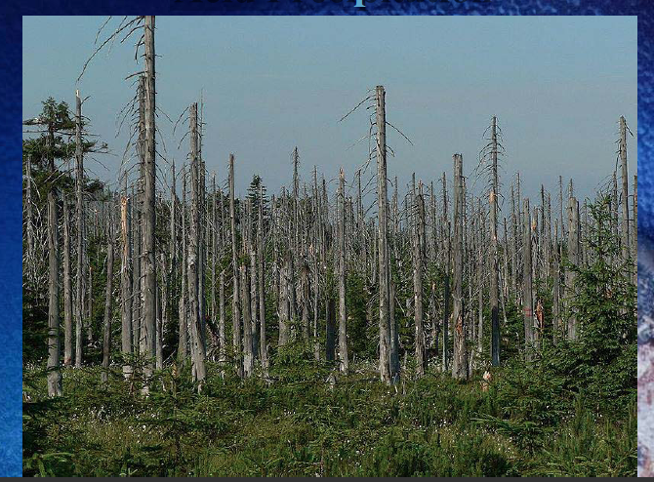
Acid Precipitation

Slide 9
Protecting Fresh Water
Conservation (Using Less)
Residential: low-flow and efficient appliances
Agriculture: low-energy sprinklers and drip irrigation
Industrial: using reclaimed or recycled water
Stricter pollution controls
Ban on damaging agricultural chemicals and herbicides
Reducing harmful industrial emissions
Water Tax?
Banning water bottles?

